Slide 1

The boundaries of bounded rationality
By Stanley Neoh Jia Jun

Slide 2
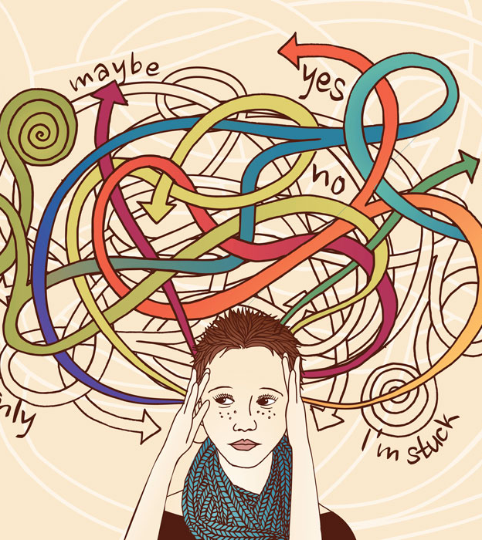
Response to choices
Satisficers | Once a satisficer encounter a choice that is good enough to meet his standard, he looks no further.
Maximisers | For a maximiser, every additional choice can lead to “anxiety, regret, and second-guessing

Slide 3

Satisficing against paradox of choice
“When you examine an object and it’s good enough to meet your standards, you look no further; thus, the countless other available choices become irrelevant.”
– Barry Schwartz (2004) on satisficing from The Paradox of Choice

Slide 4
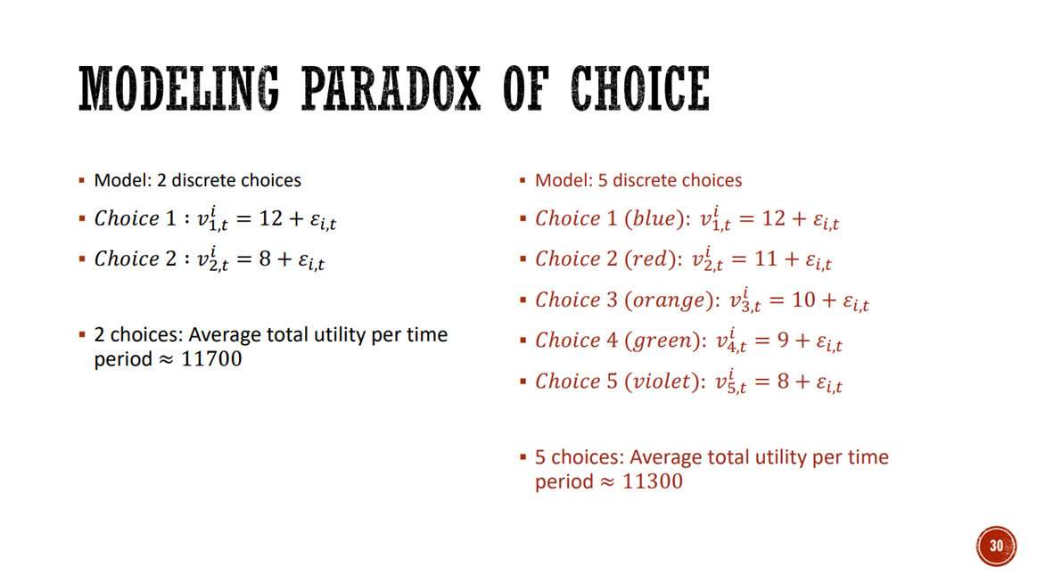
Satisficing in Agent-based modelling
Why is paradox of choice is still exhibited?
What assumptions are made?
Does the result extend for >2 options?
What happens when we consider herding?
- Taken from Seminar 8 Slide 30

Slide 5
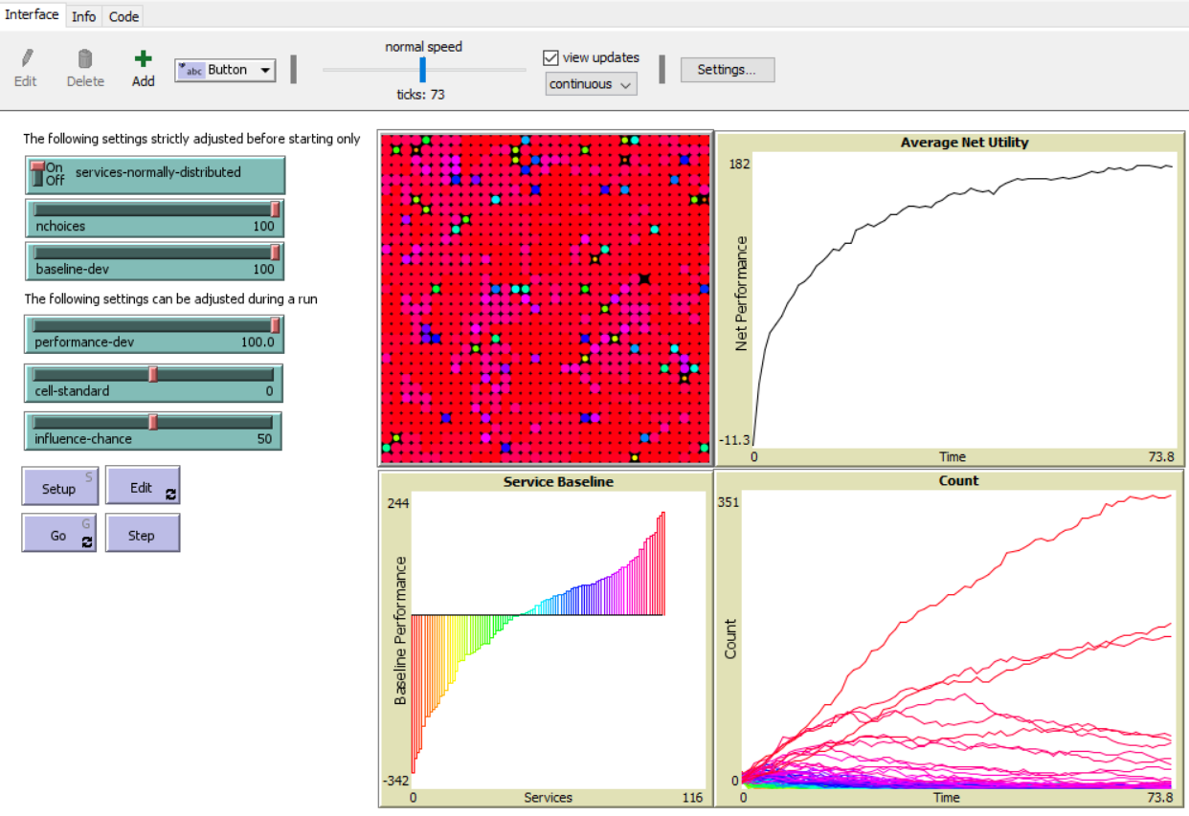
Scope of study
Adapt existing Paradox of Choice model to handle
More choices (2 to 100)
Normally distributed choices
Different levels of uncertainty
Different degrees of herding behaviour
Research questions
Does more choices still lead to the paradox of choice?
How does the distribution of choices affect the paradox of choice?
How does uncertainty impact average utility?
What happens if we consider herding behaviour?

Slide 6
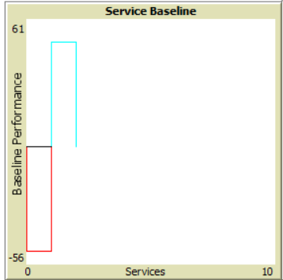
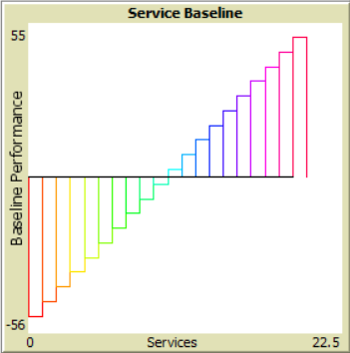
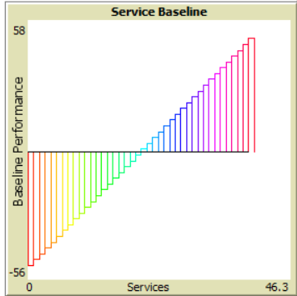
“Bounded” Linear distribution
Each bar represents a choice
Height of bar represent average utility from that choice
Best and worst choices bounded by fixed values
Choices between are linearly interpolated

Slide 7
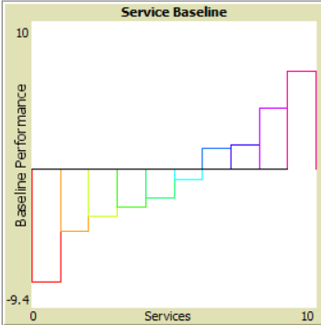
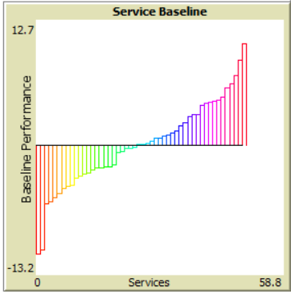
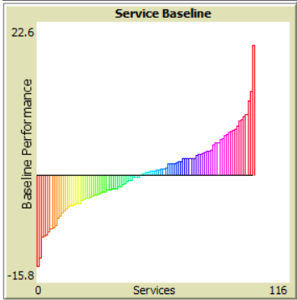
Normal distribution
Each bar represents a choice
Height of bar represent average utility from that choice
Best and worst choices are not bounded
Each choice is randomly selected from a normal distribution

Slide 8
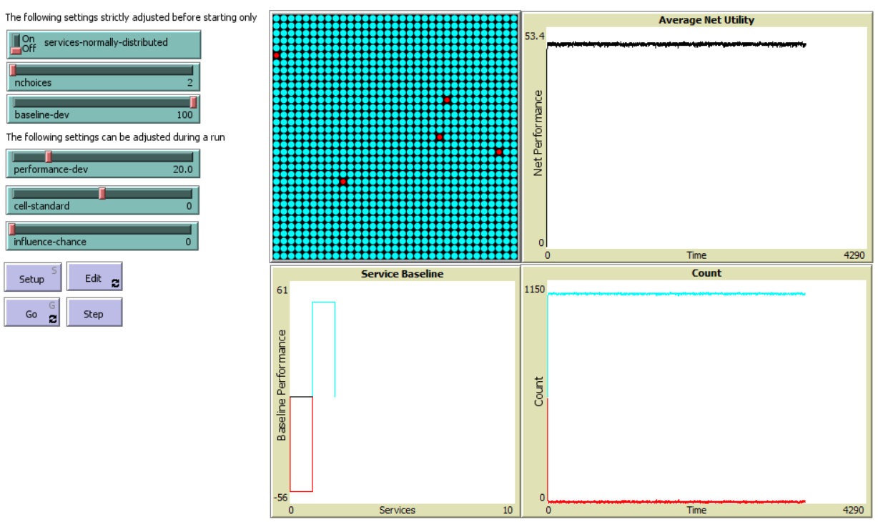
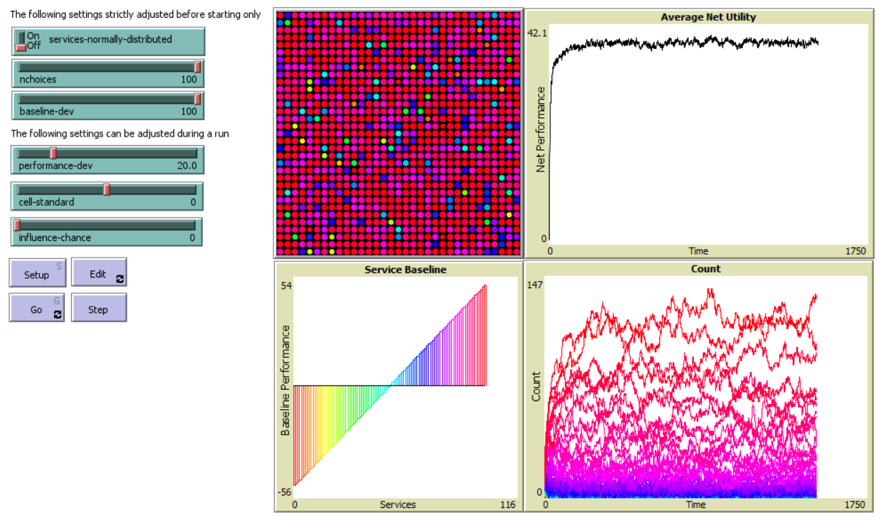
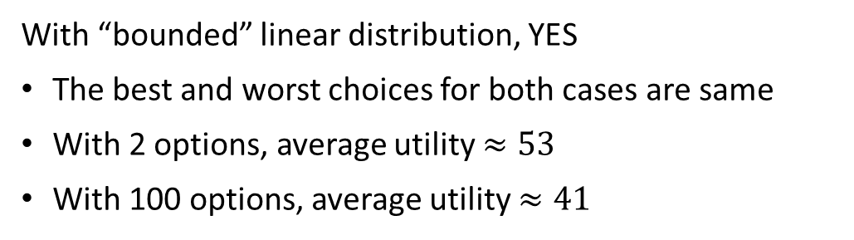
Does Paradox of Choice still show?
With “bounded” linear distribution, YES
The best and worst choices for both cases are same
With 2 options, average utility $≈53$
With 100 options, average utility $≈41$

Slide 9
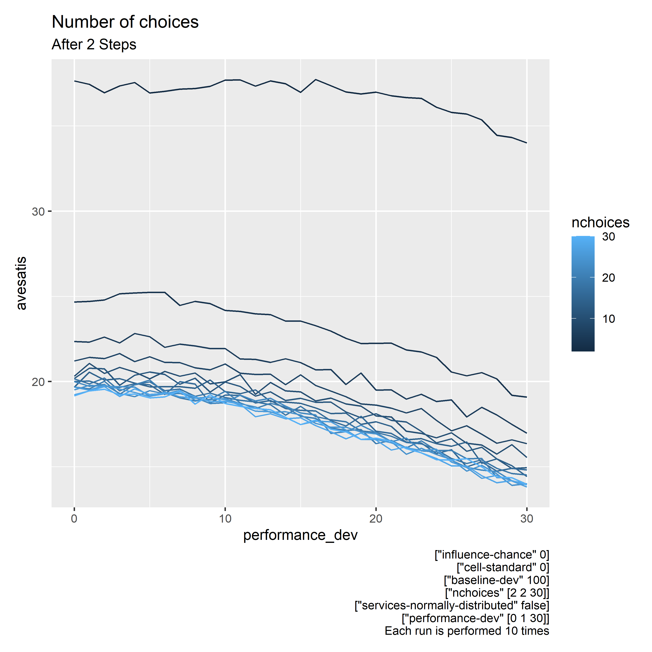

Slide 10
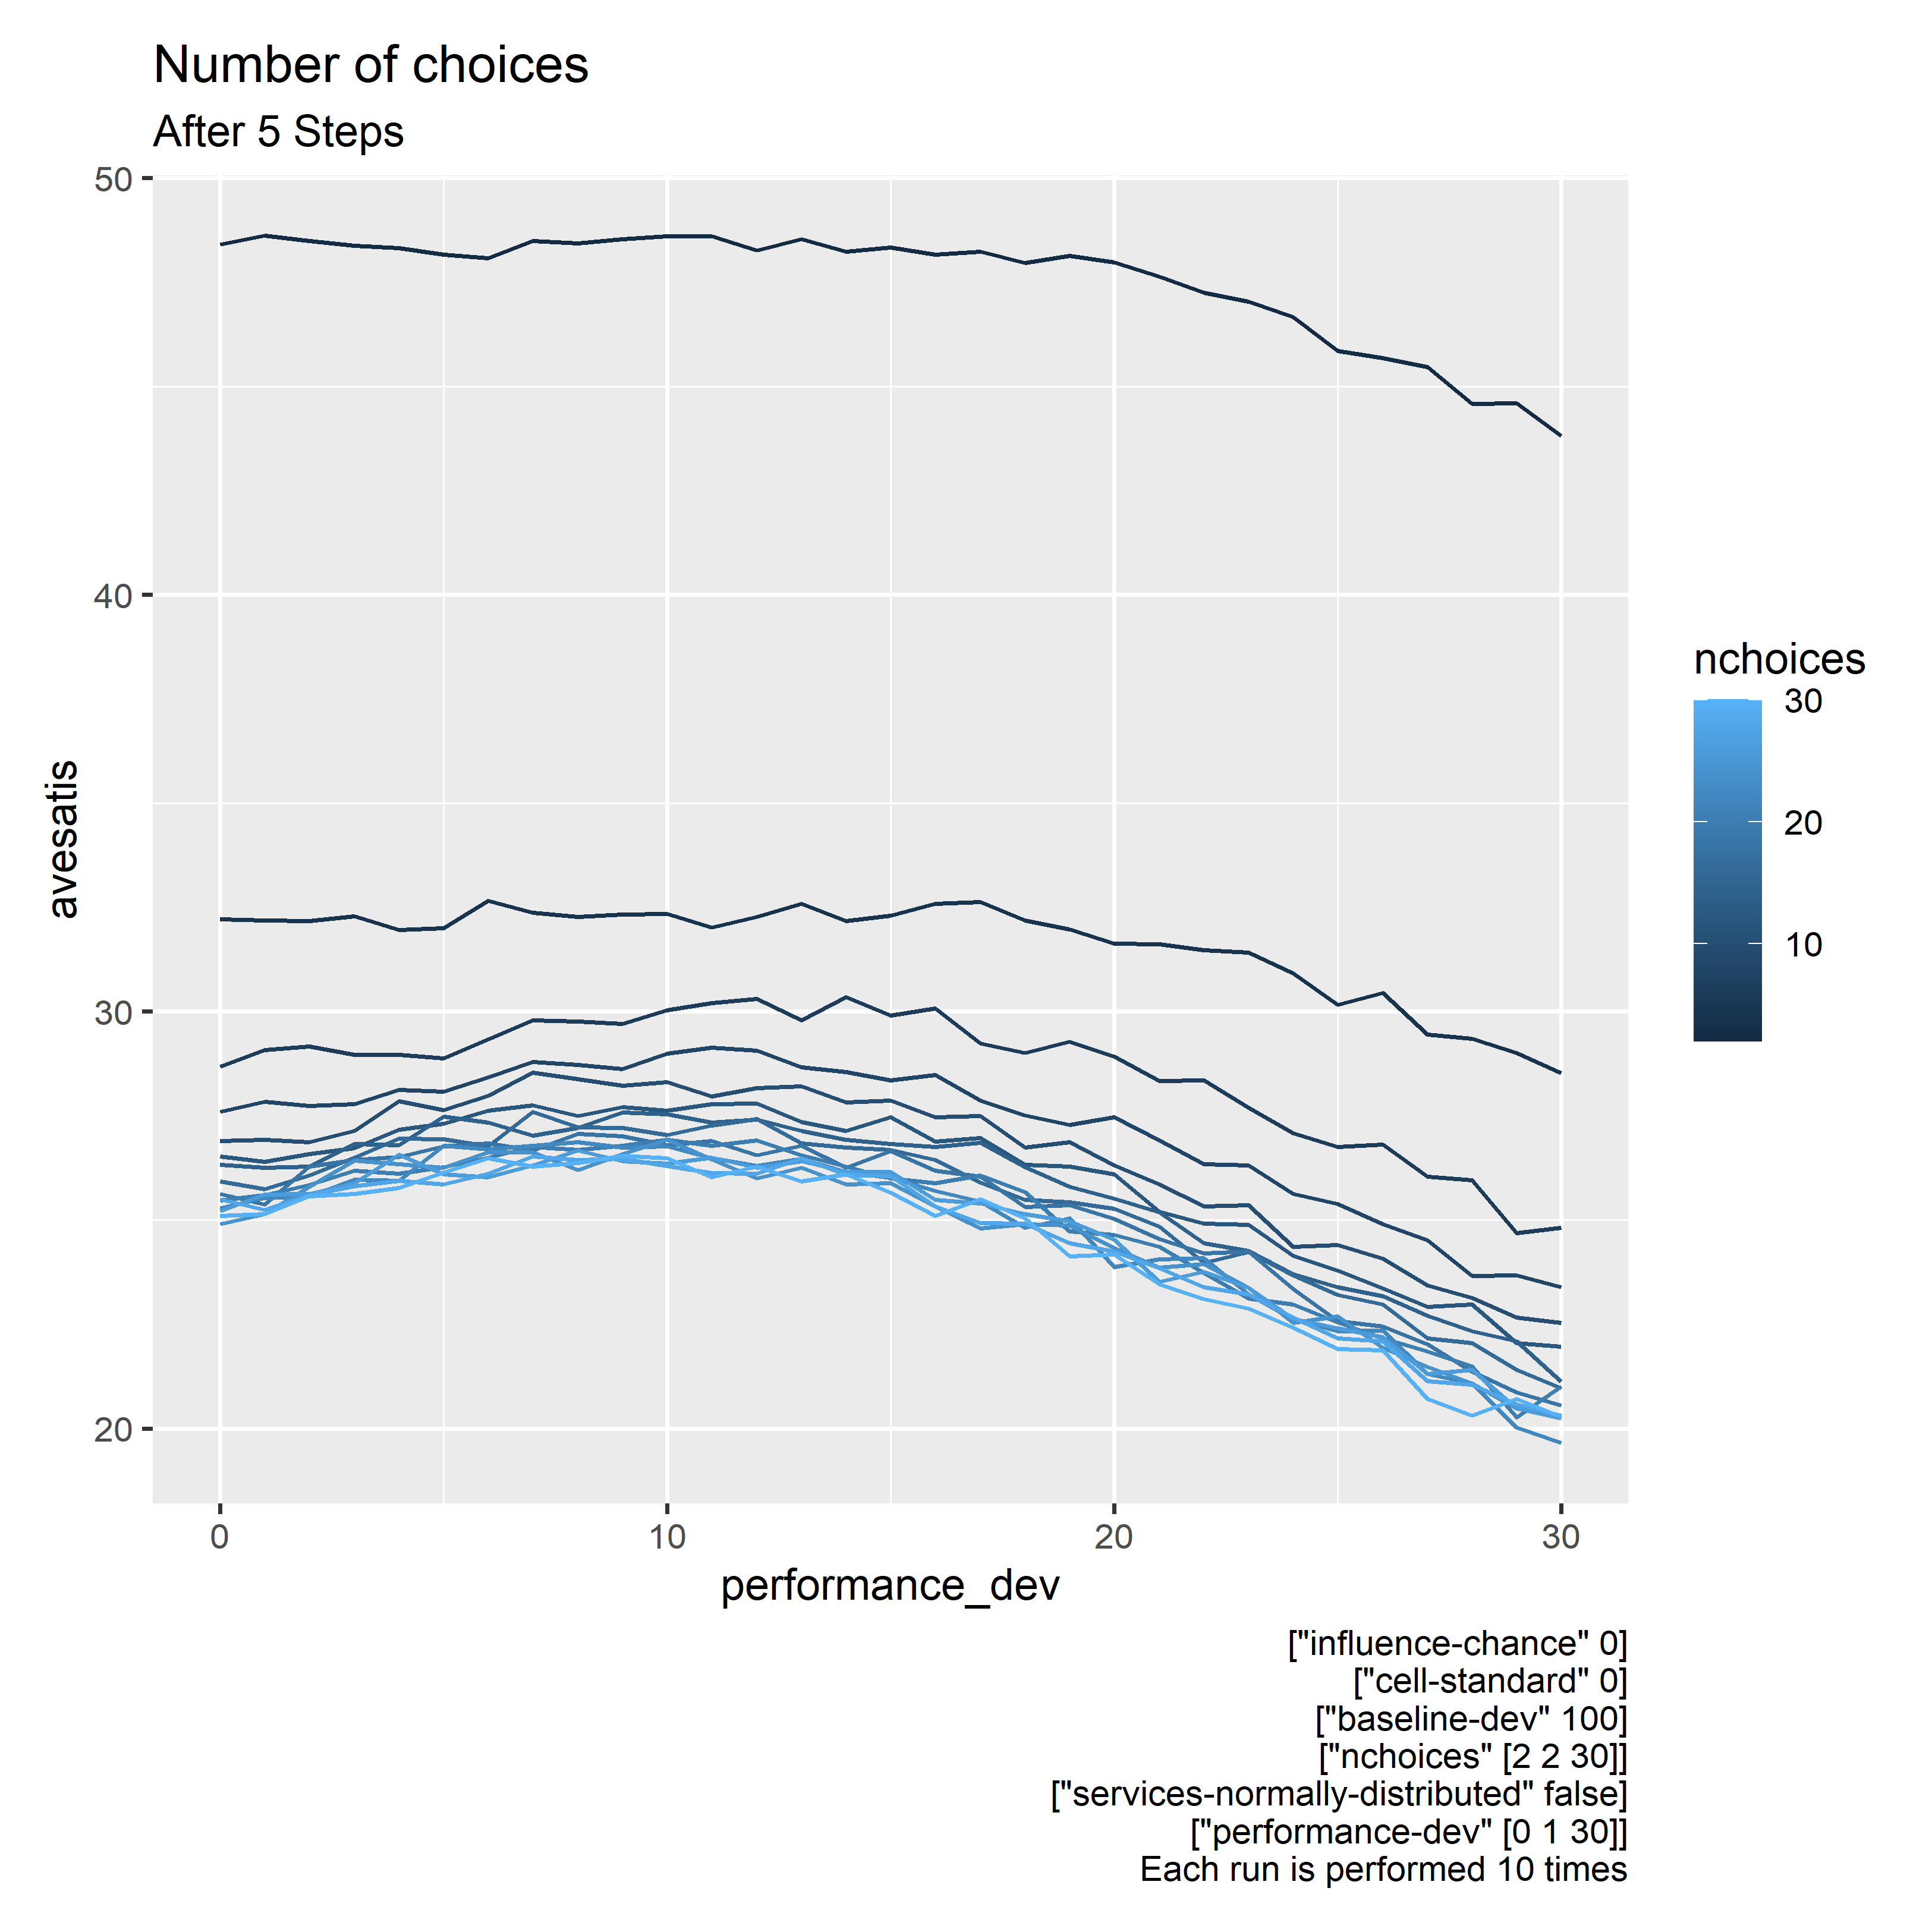

Slide 11
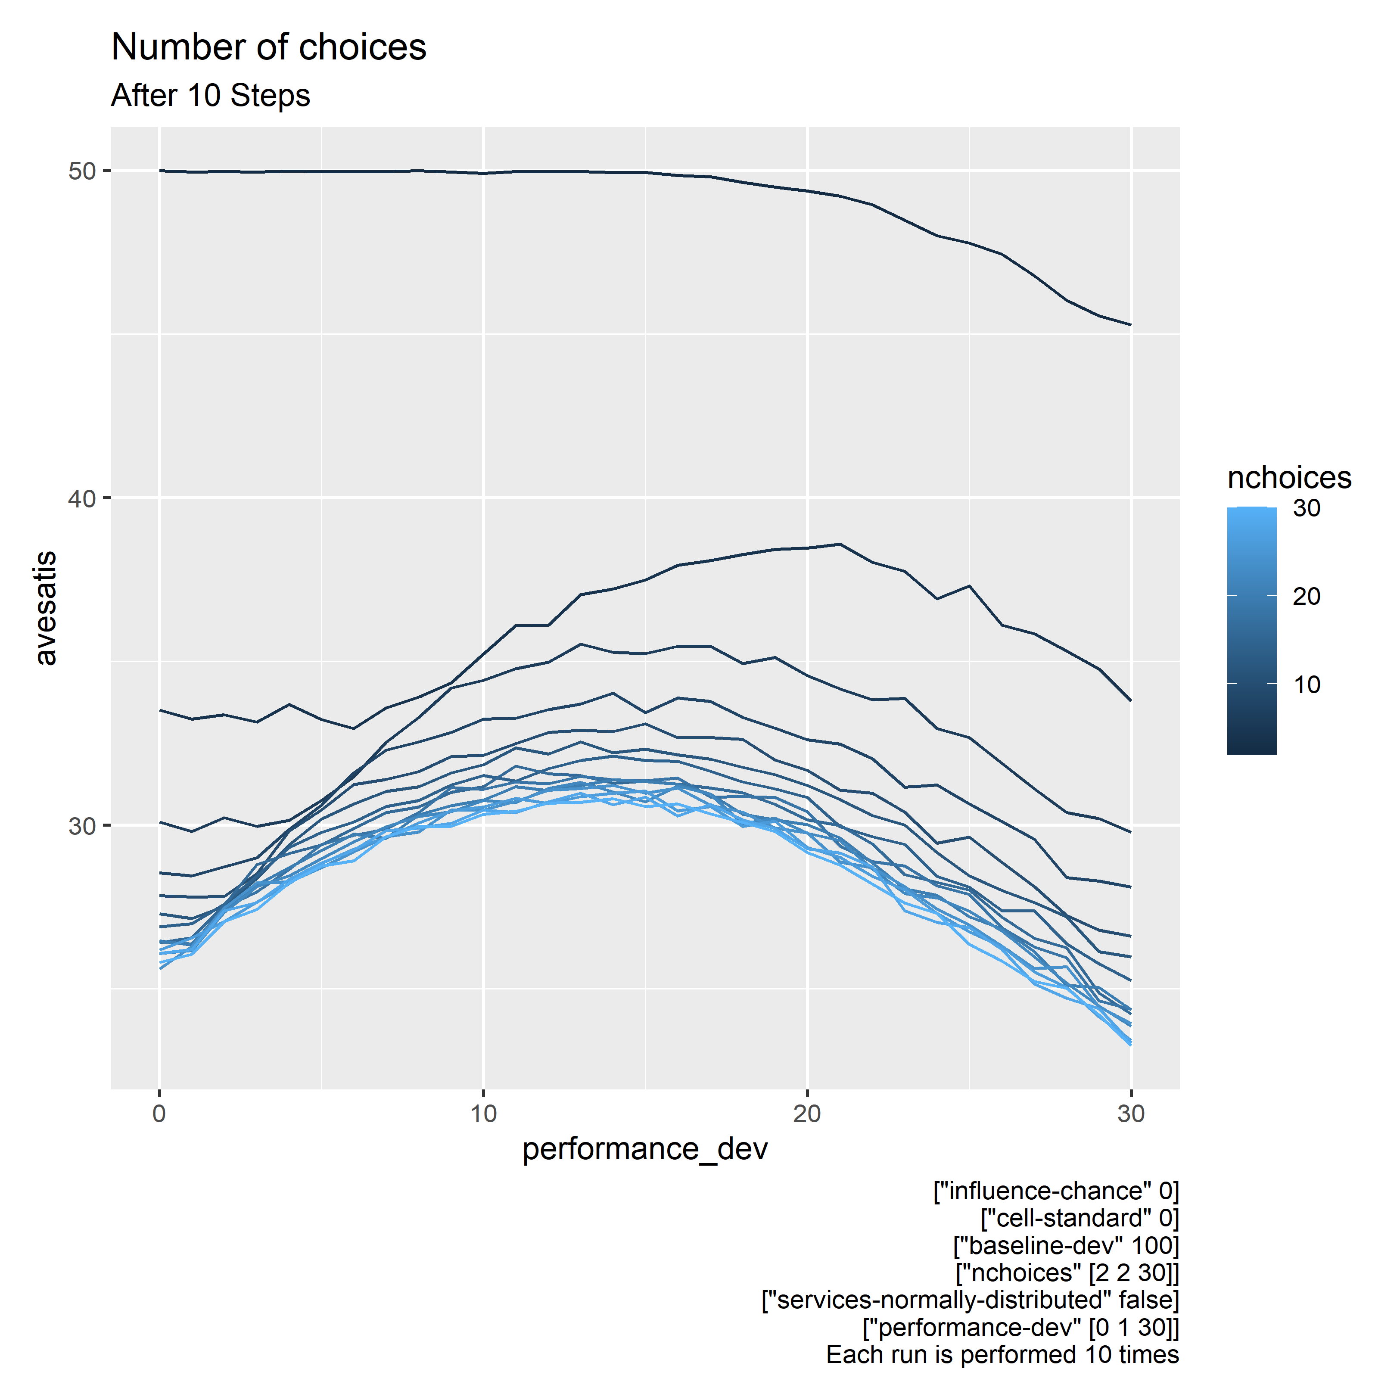

Slide 12
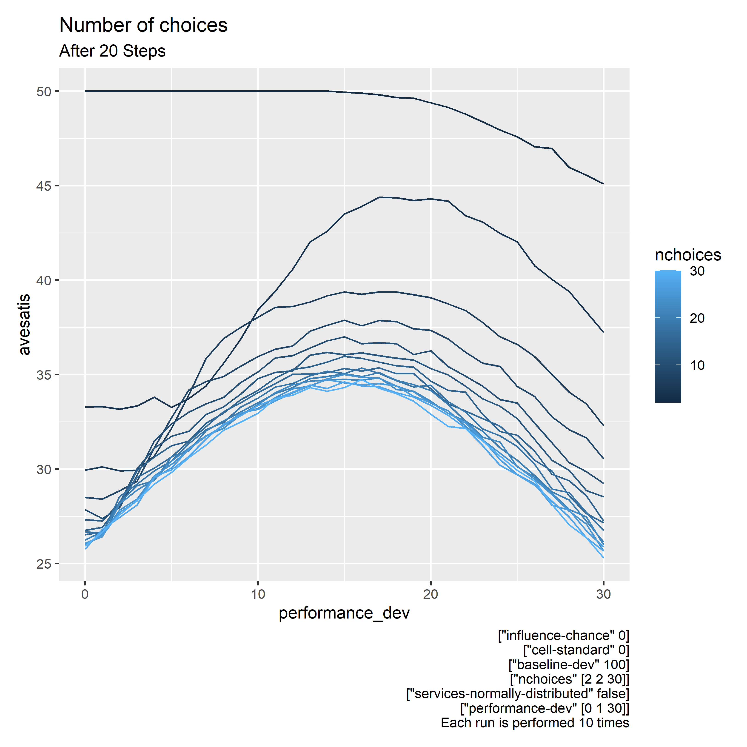

Slide 13
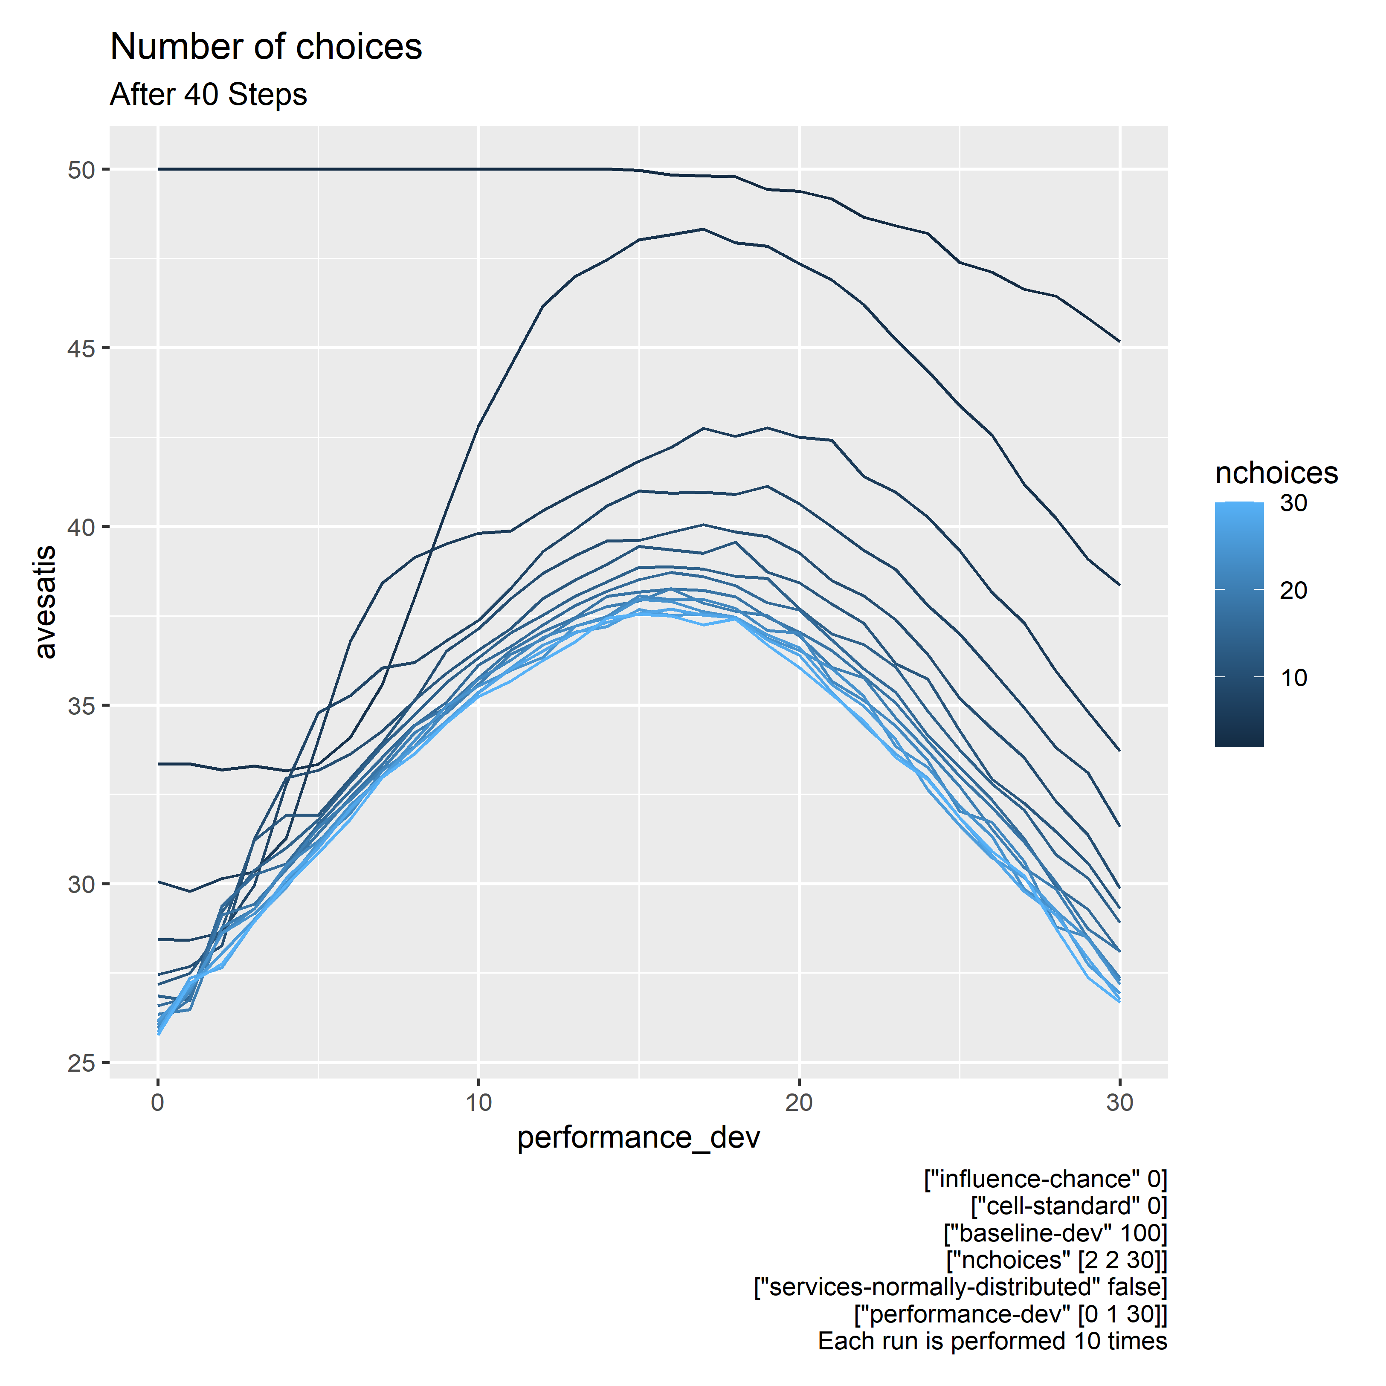

Slide 14
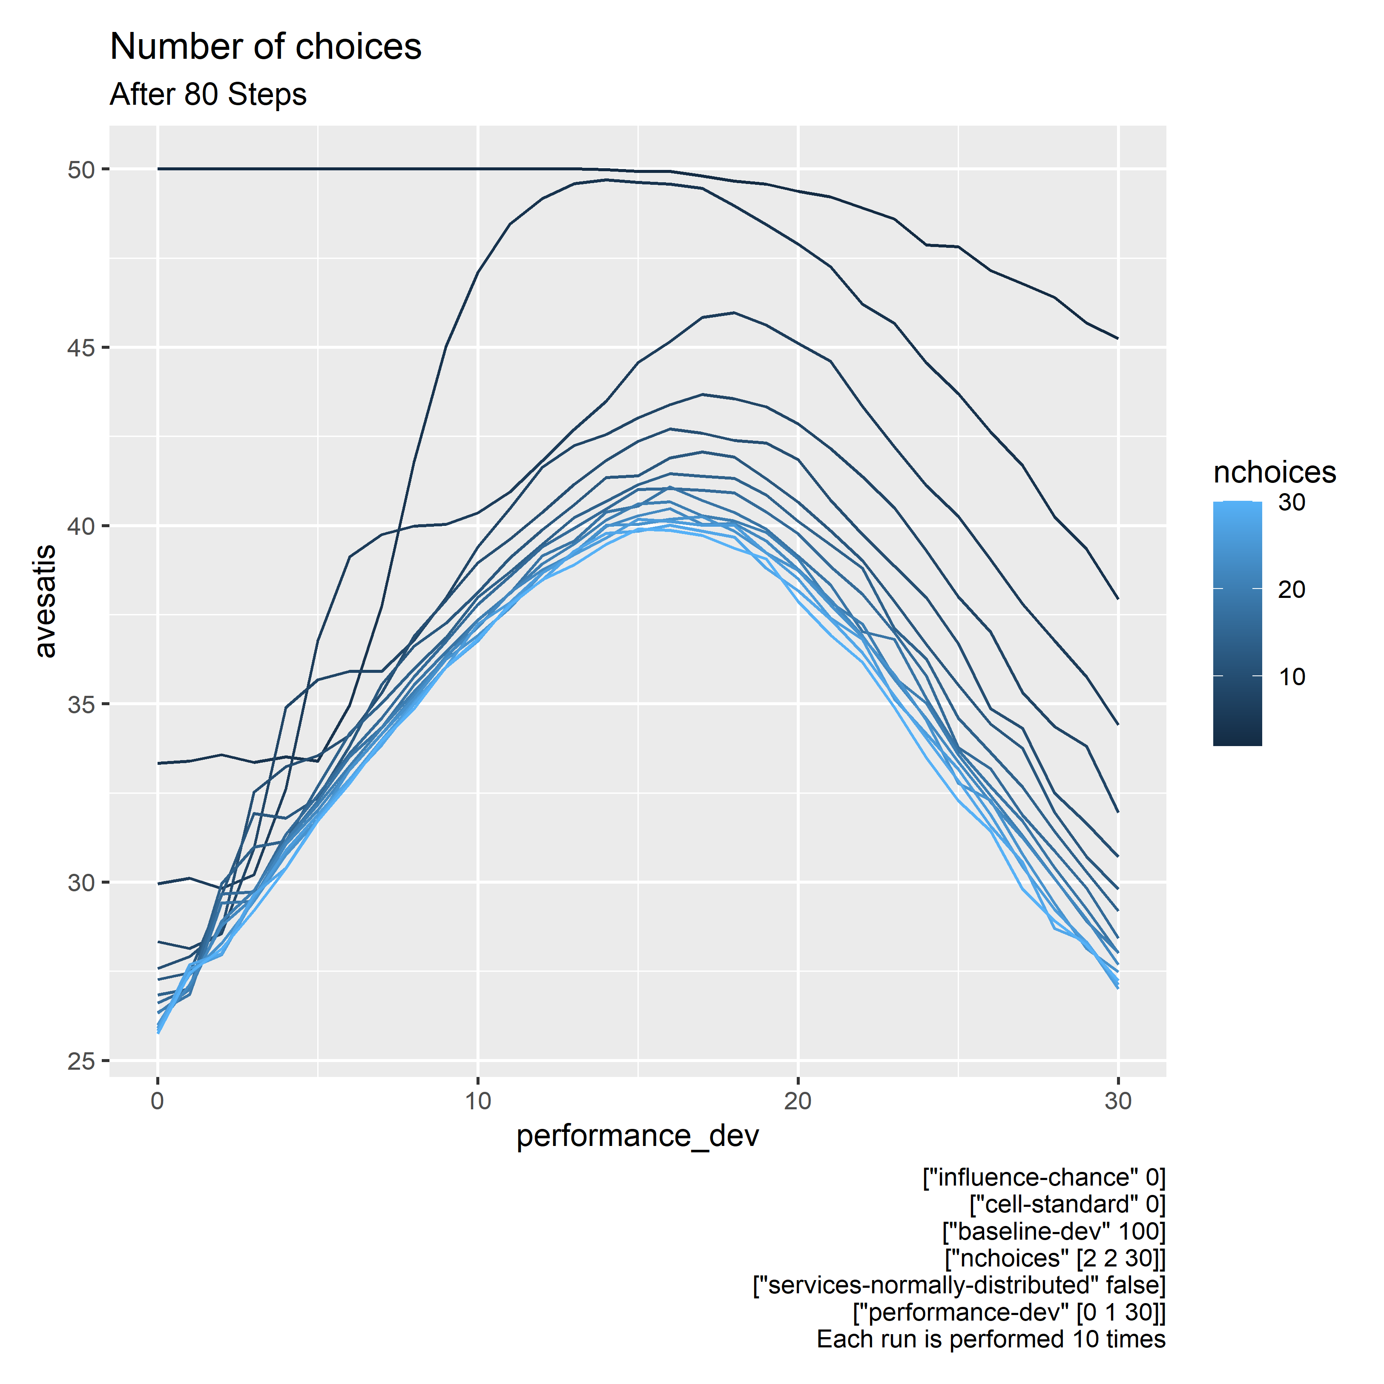

Slide 15
Observations
Clearly, less options is better
With few steps, utility decreases with uncertainty
After many steps, some uncertainty brings about more utility
What happens if the choices were normally distributed?

Slide 16
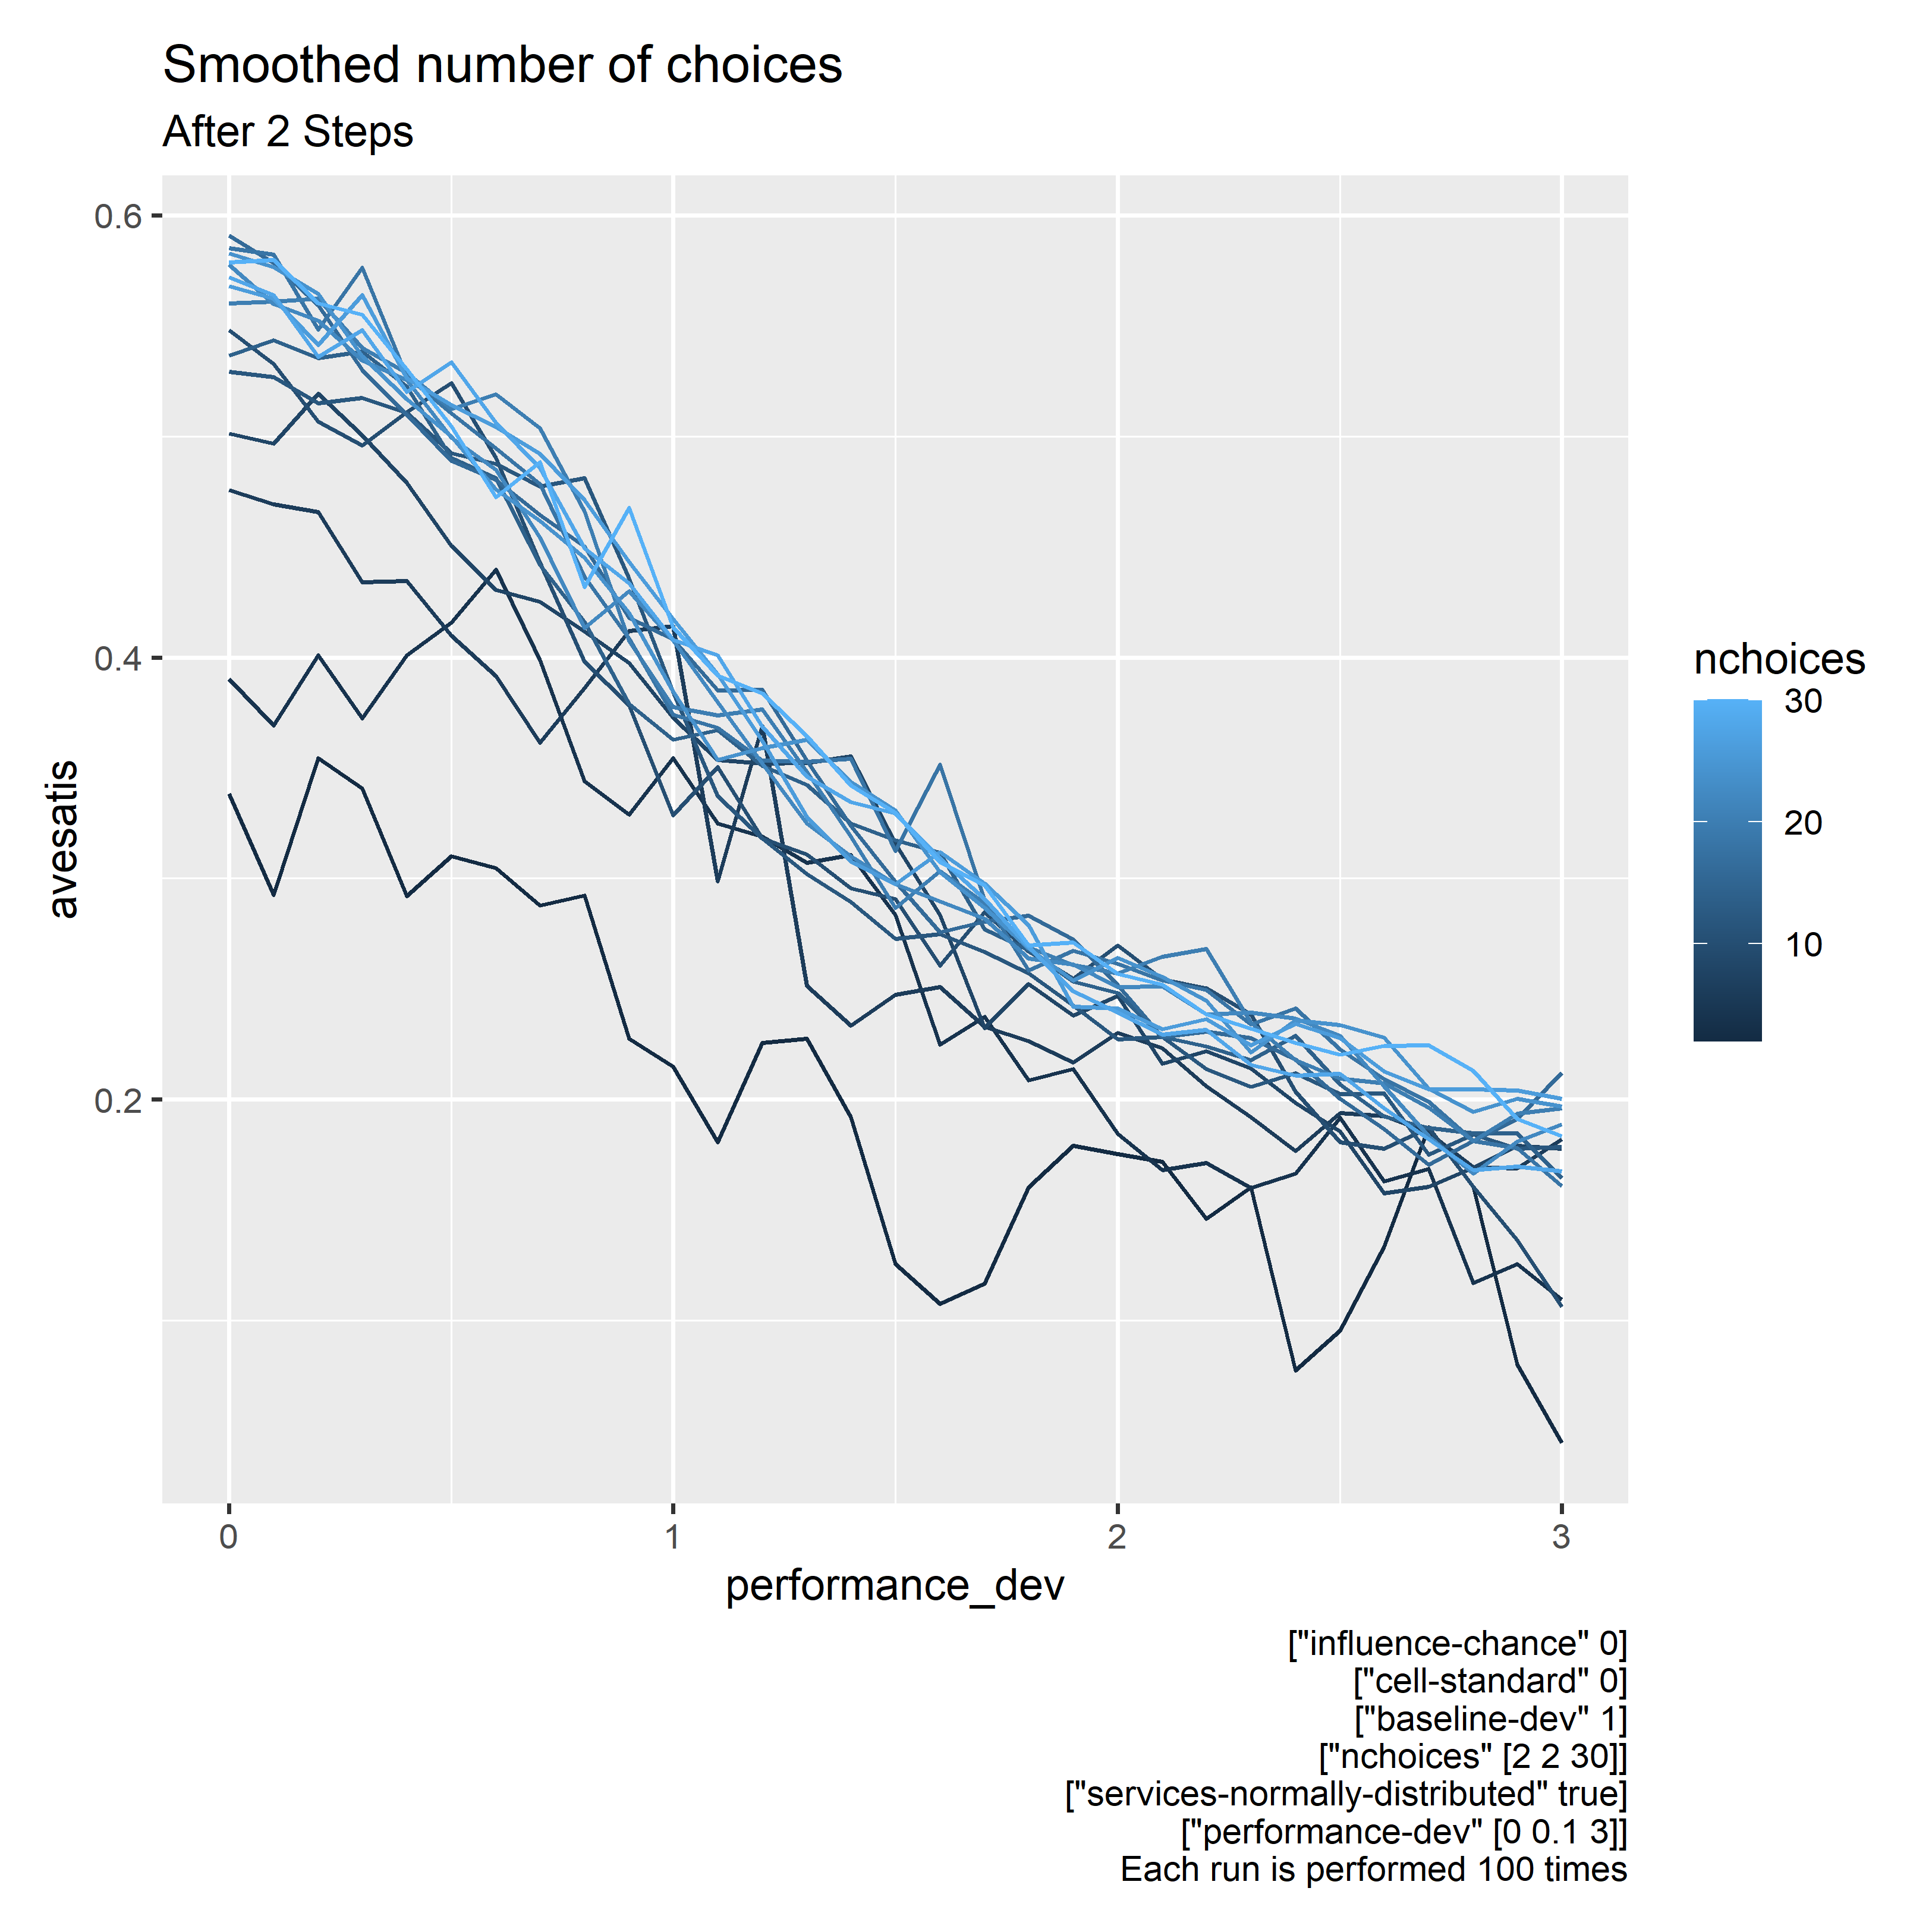

Slide 17
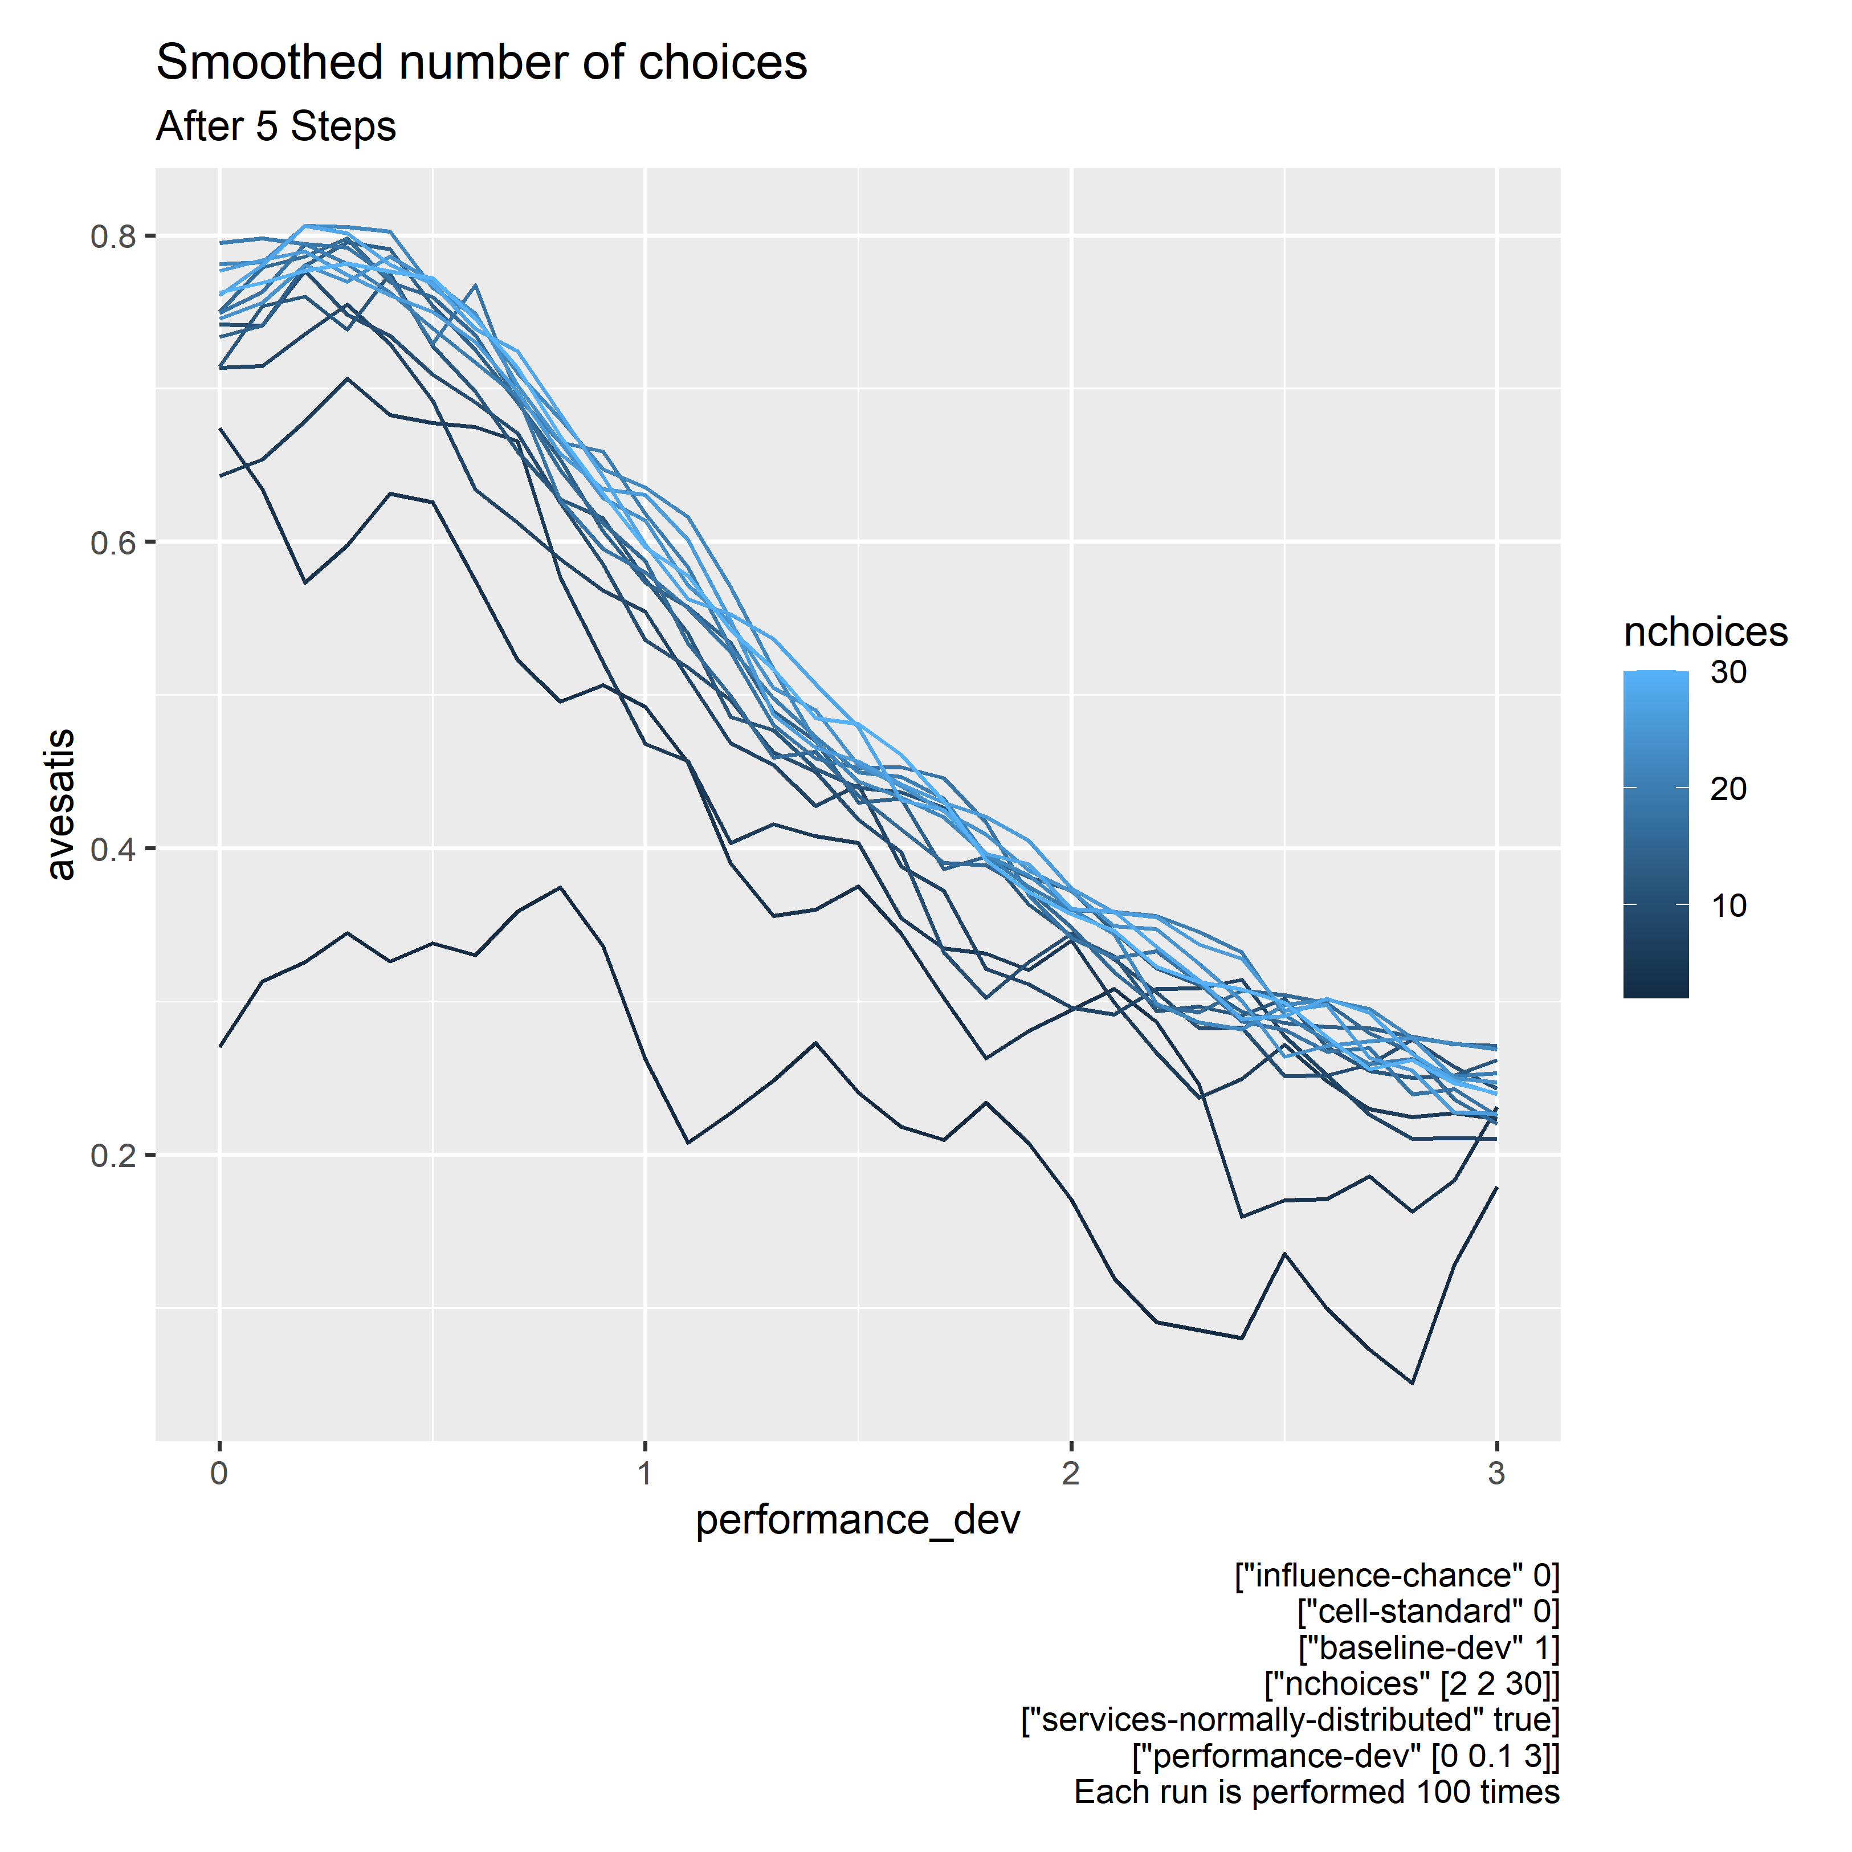

Slide 18
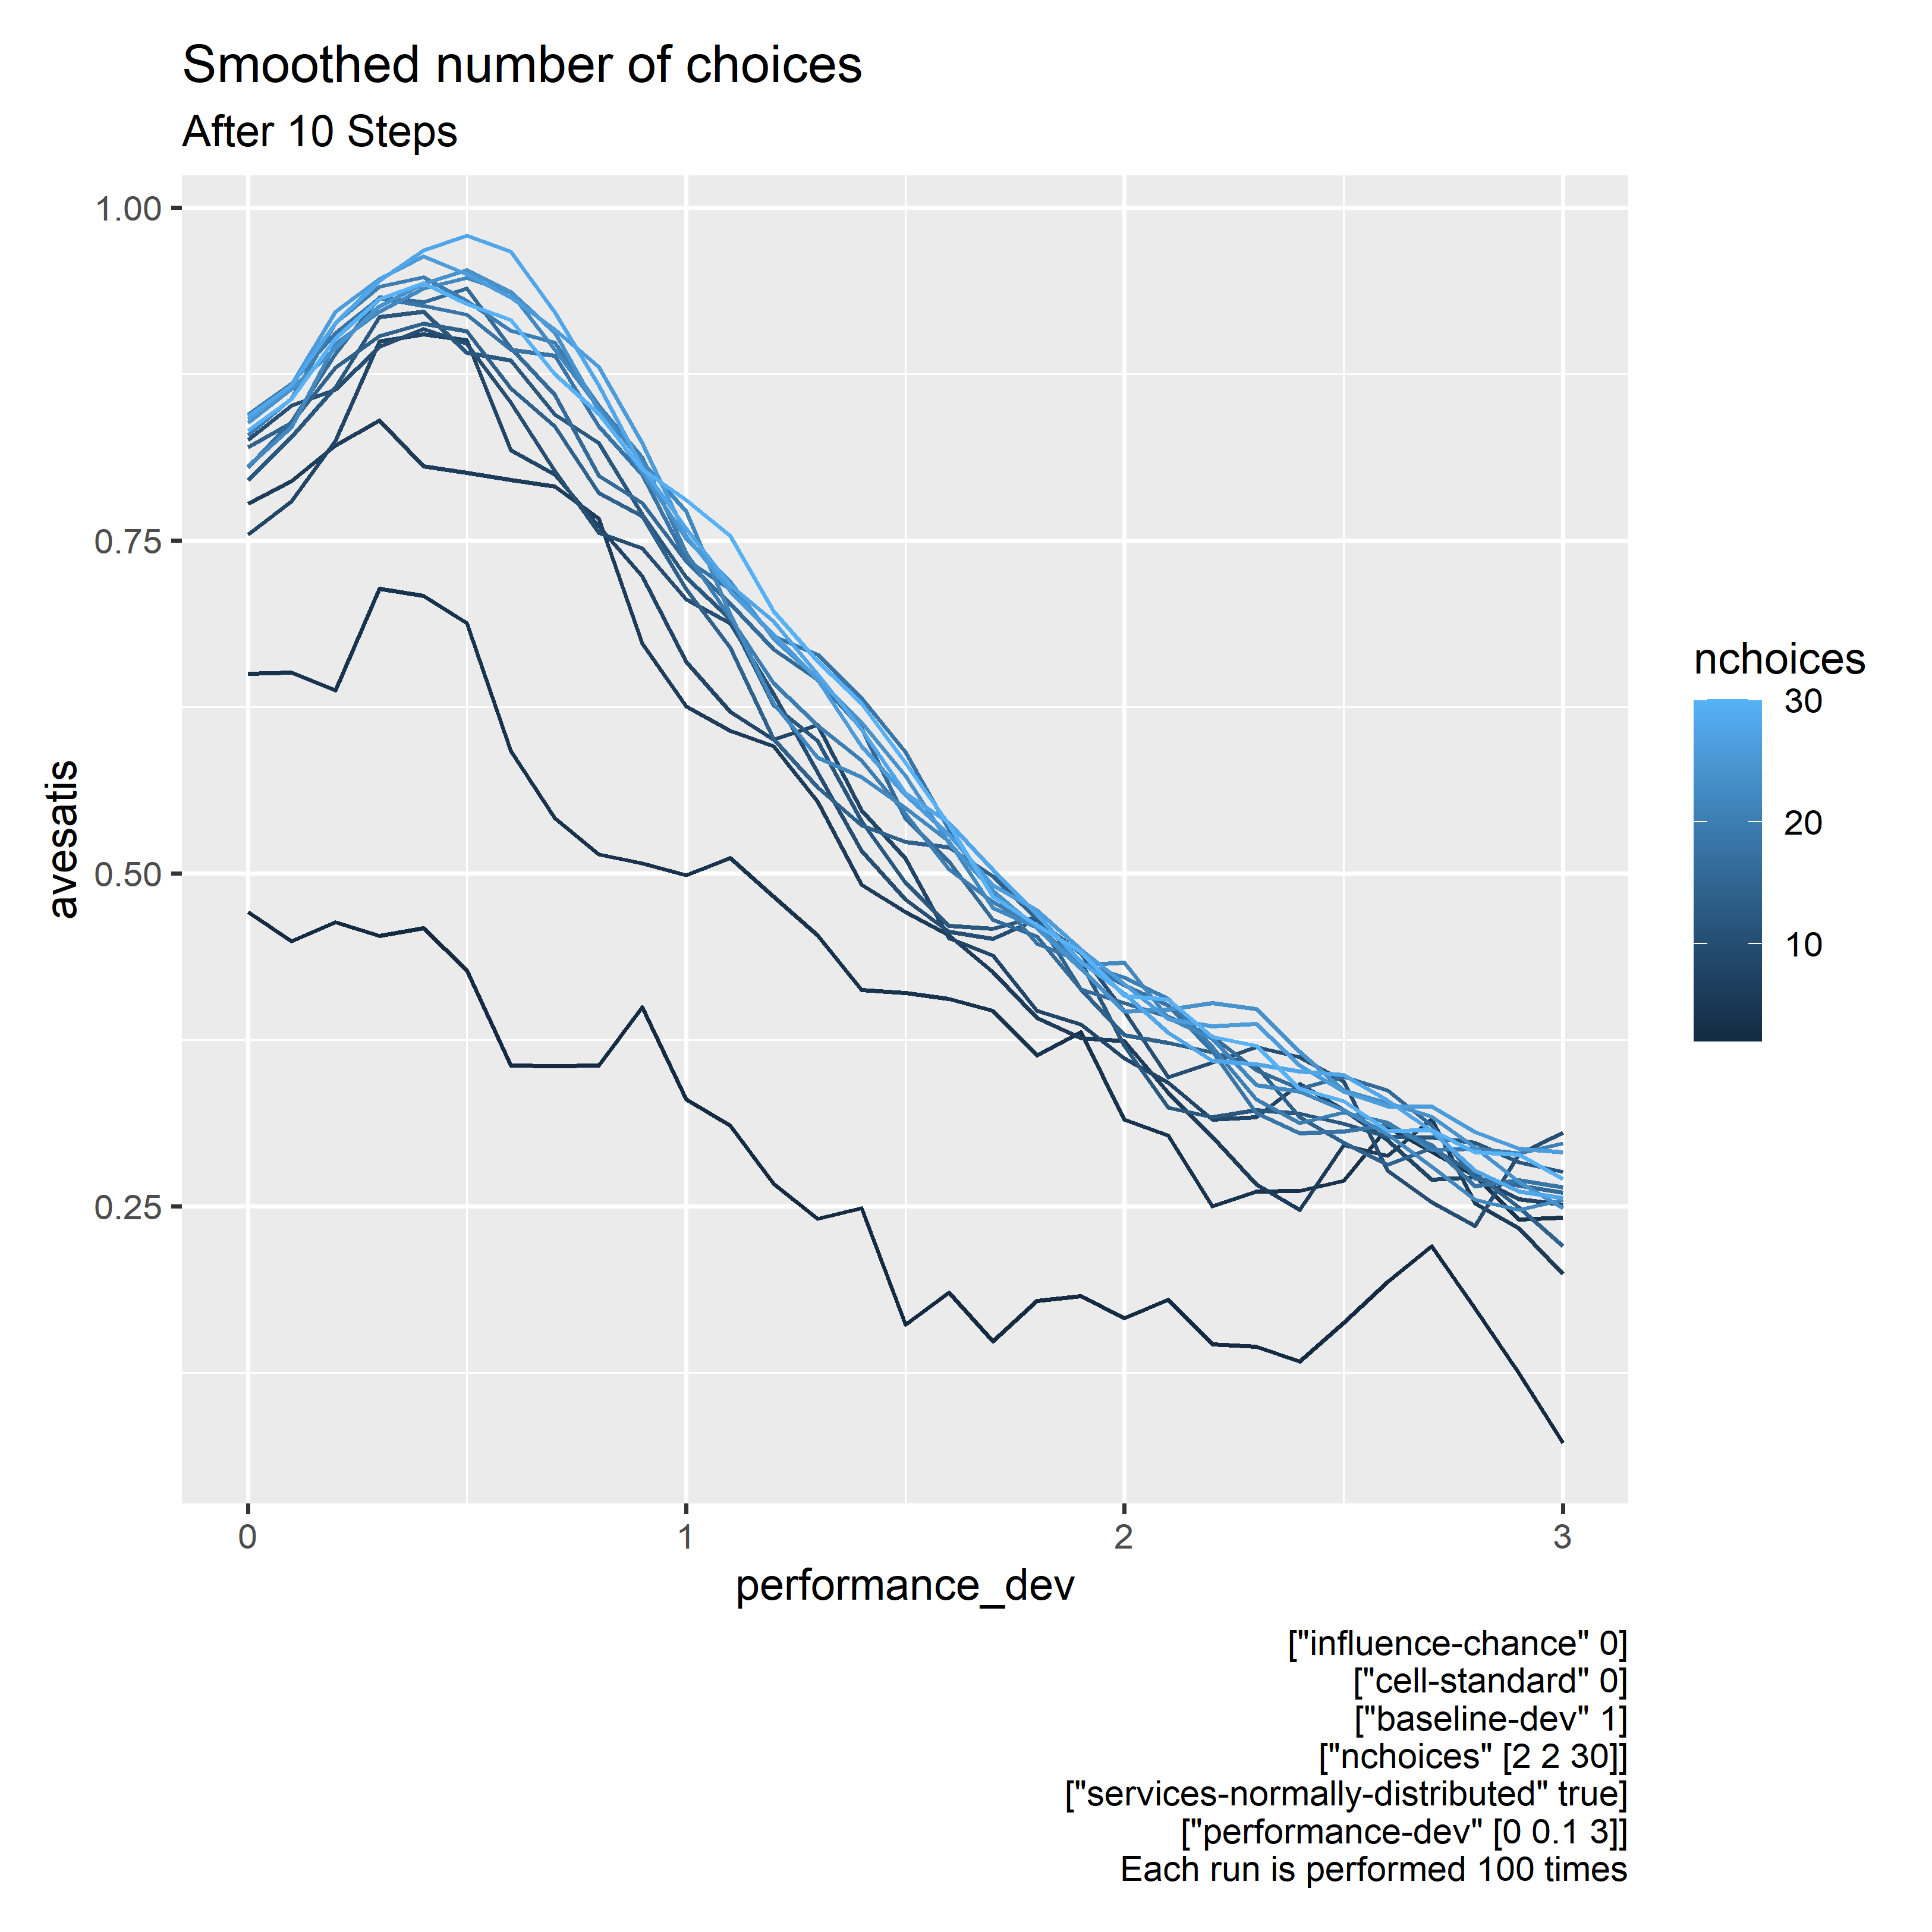

Slide 19
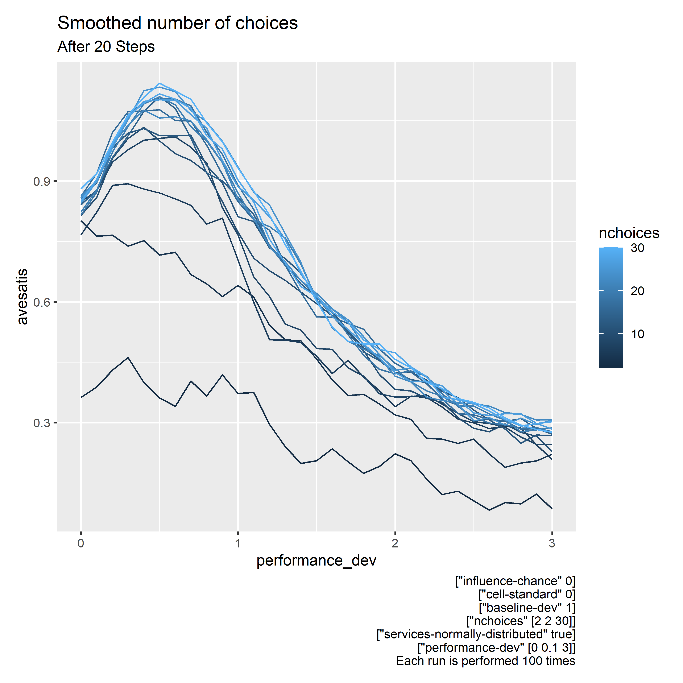

Slide 20
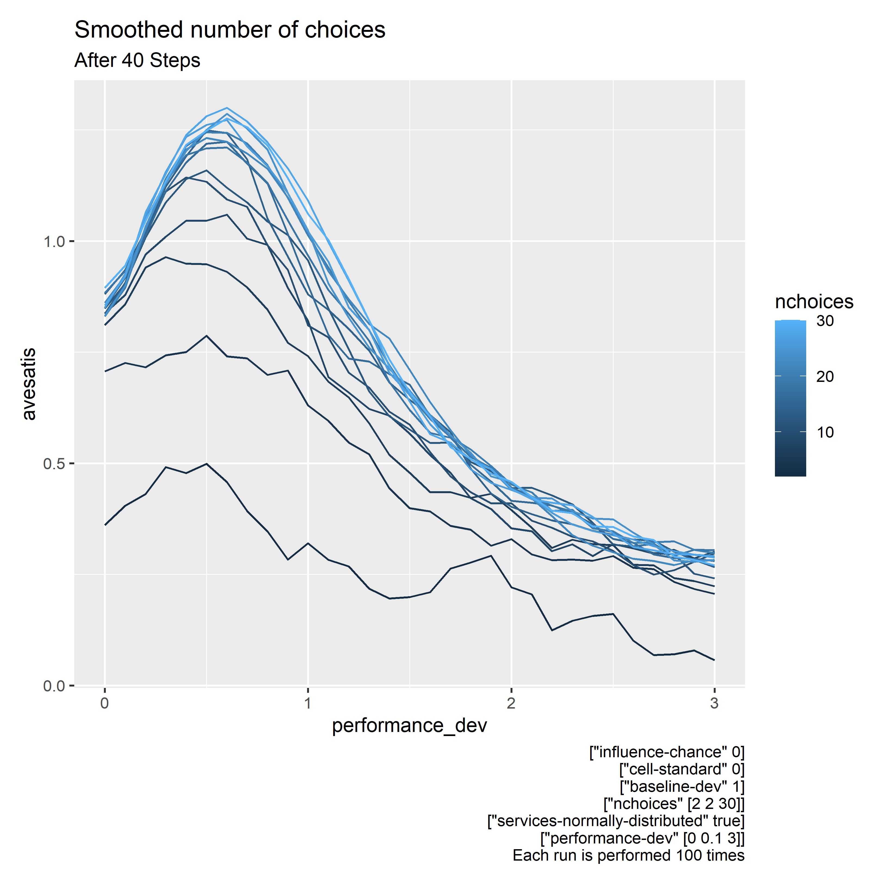

Slide 21
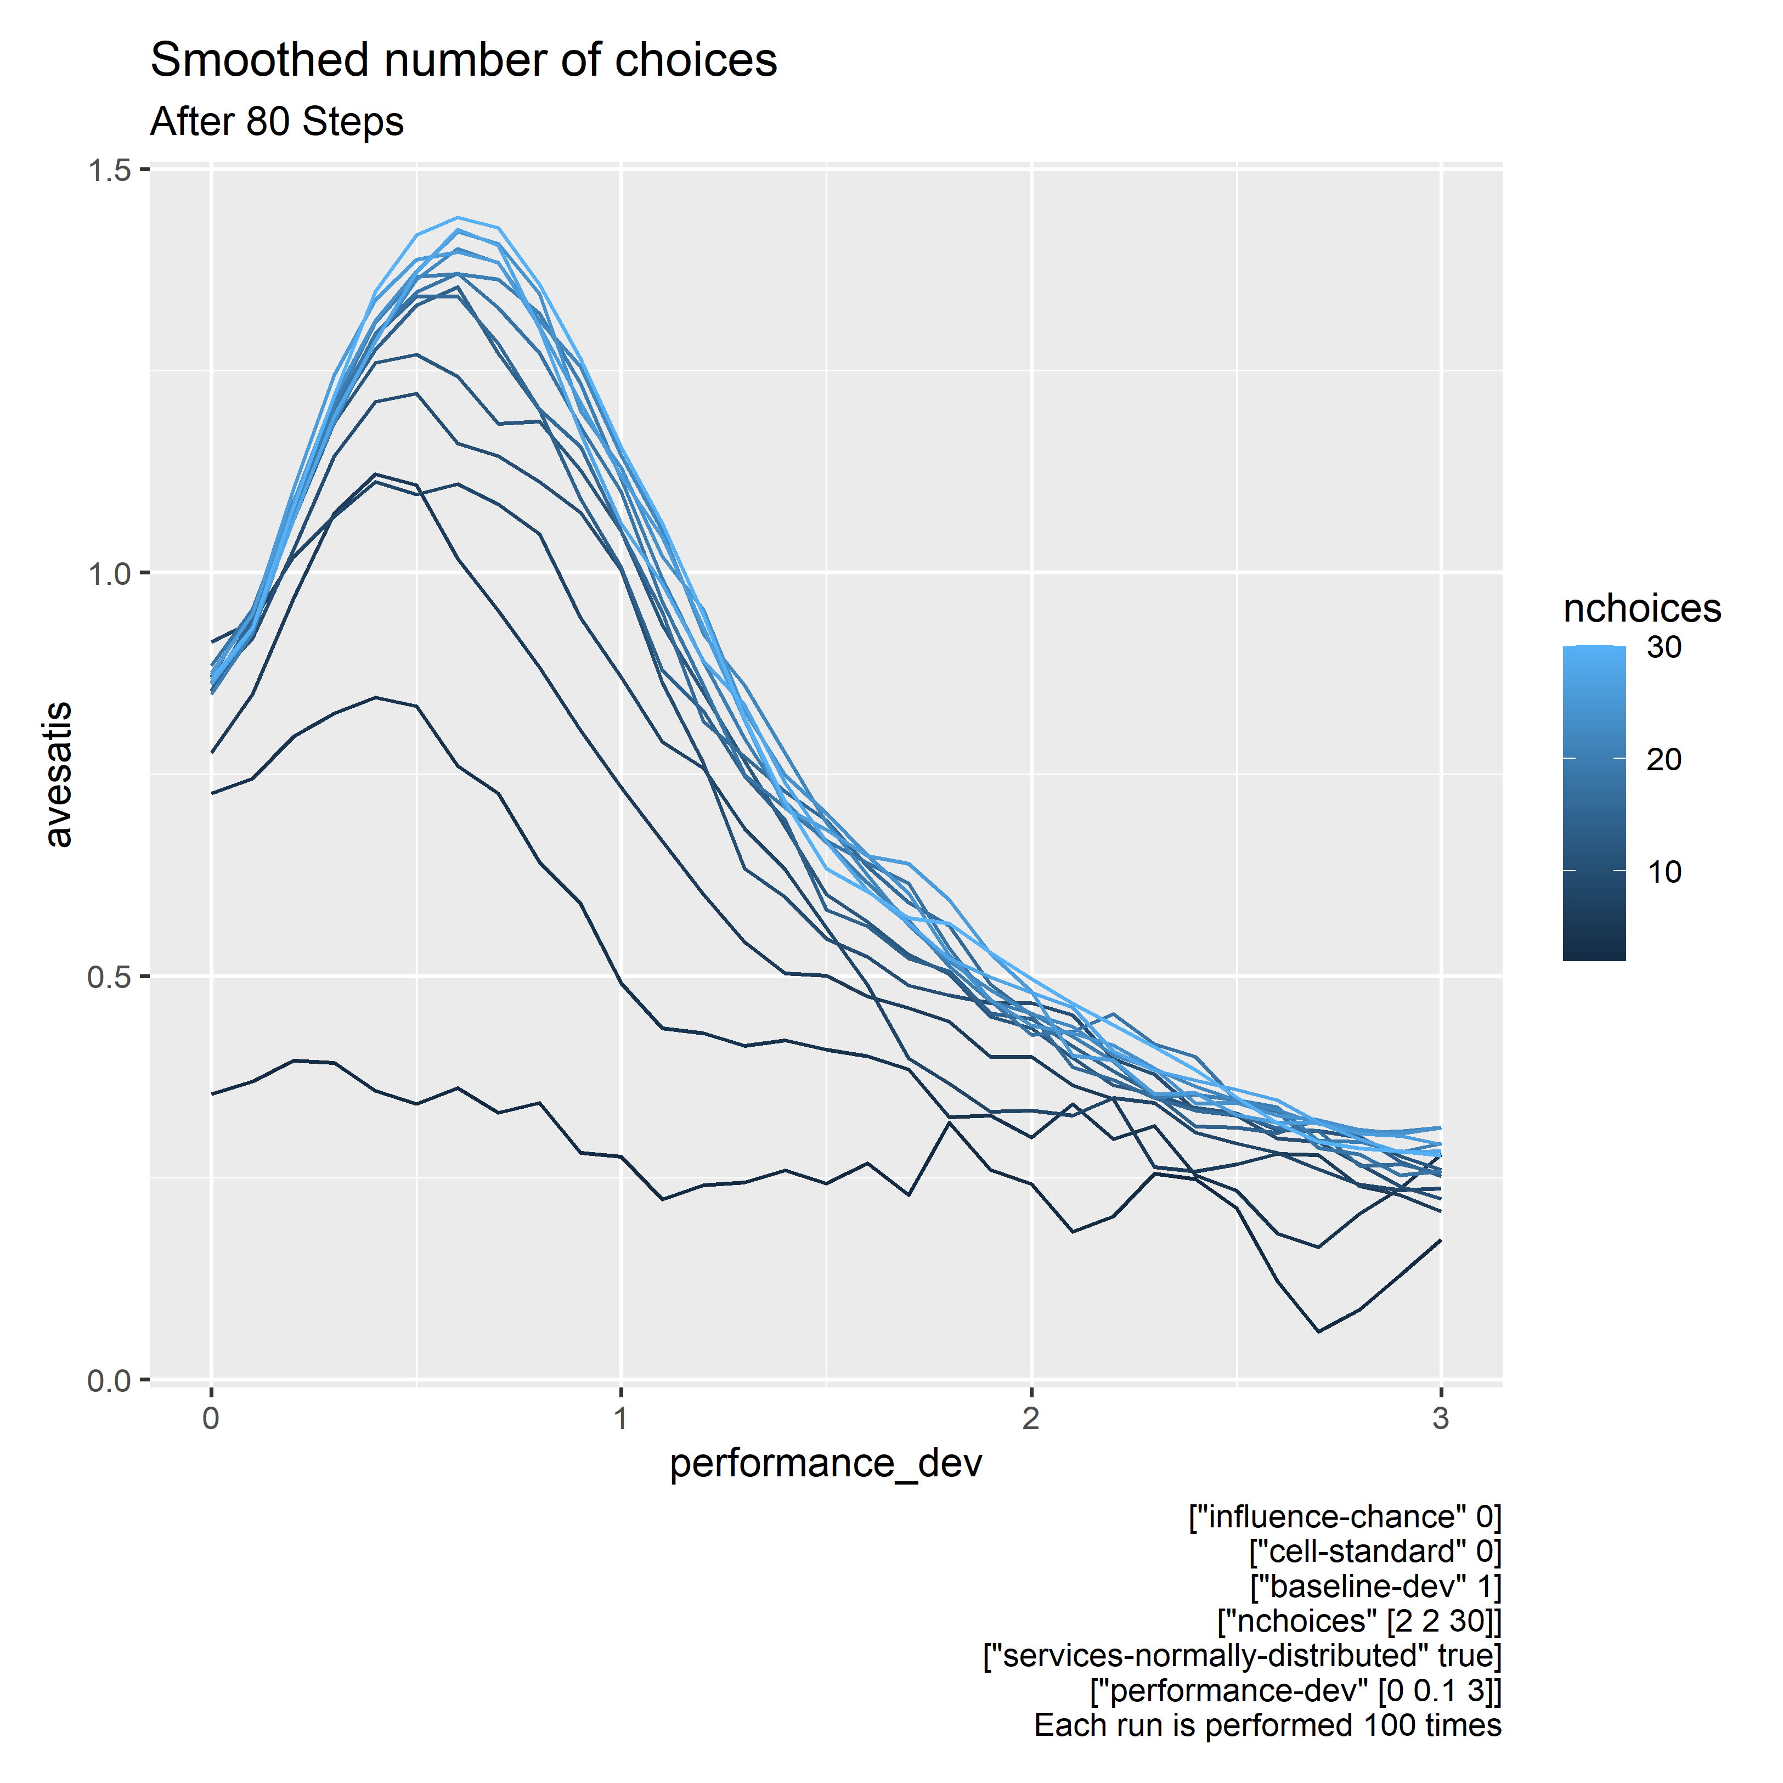

Slide 22
Observations
Paradox of choice disappears, more options is better
Similar to with ‘bounded’ linear distribution
With few steps, utility decreases with uncertainty
After many steps, some uncertainty brings about more utility
We want better choices, not more choices.

Slide 23
Unanswered questions
With few steps, less uncertainty = more utility
This makes intuitive sense
With more steps, why does utility peaks when there is some uncertainty?
Perhaps analogous to leaving comfort zone for greener pastures

Slide 24
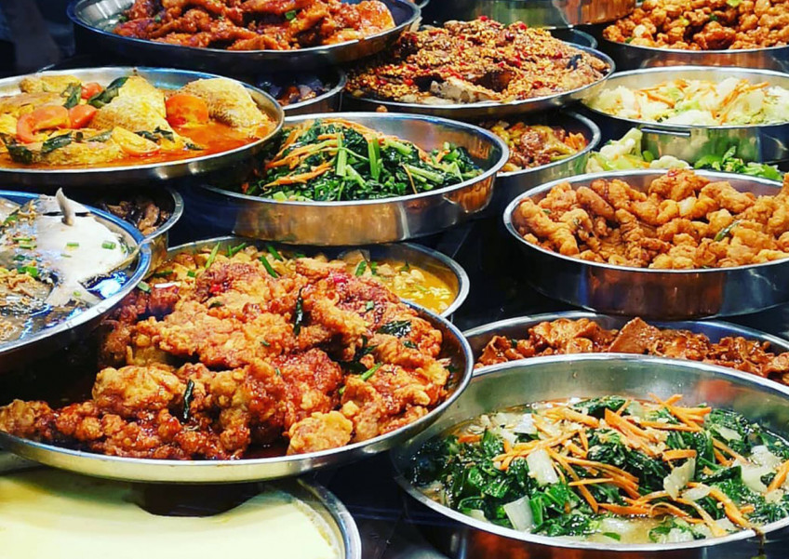

Why is chicken rice so popular?
Notes:
I don’t know about you all, but sometimes when I go out for lunch, I usually go for the cheap options if its not any special occasion or whatsoever. I will go over to the caifan store, look at the vast number of options and cannot decide what to choose. So in the end I just go over to the chicken rice stall. Nice and simple
But when we look at the 2 foods, I argue that caifan is an objectively more complete option compared to chicken rice and its sometime strange to me how such a stall selling only chicken, rice and a bit of extra stuff on the side become the most recognizable food in Singapore. My hypothesis is that is not simply just the taste but other aspects that stems from how we decide.

Slide 25
Trying a new coffee shop
Very standard
Few number of choices
Low uncertainty
Hard for chicken rice to go very wrong
Large number of choices
High uncertainty
don’t know what to expect from each choice

Slide 26
A familiar coffee shop
No reason to try out their duck rice or chicken noodles if satisfied with chicken rice
Better understanding of the go-to choices
Provided that uncertainty is not excessive

Slide 27
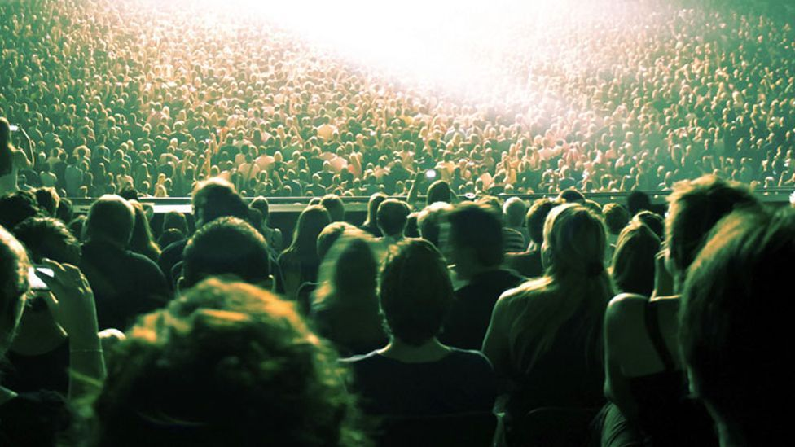
Wisdom of the crowd
Rational herding behaviour

Slide 28
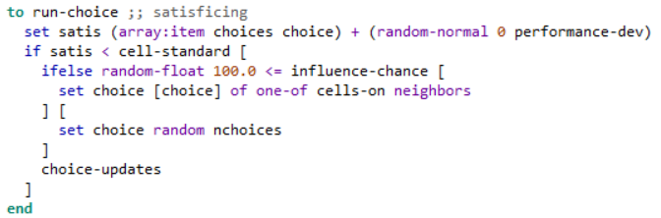
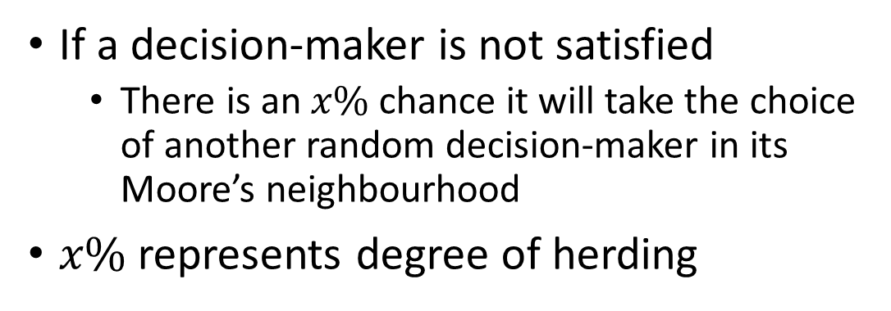
Modification to agent-based model
If a decision-maker is not satisfied
There is an $x\%$ chance it will take the choice of another random decision-maker in its Moore’s neighbourhood
$x\%$ represents degree of herding

Slide 29
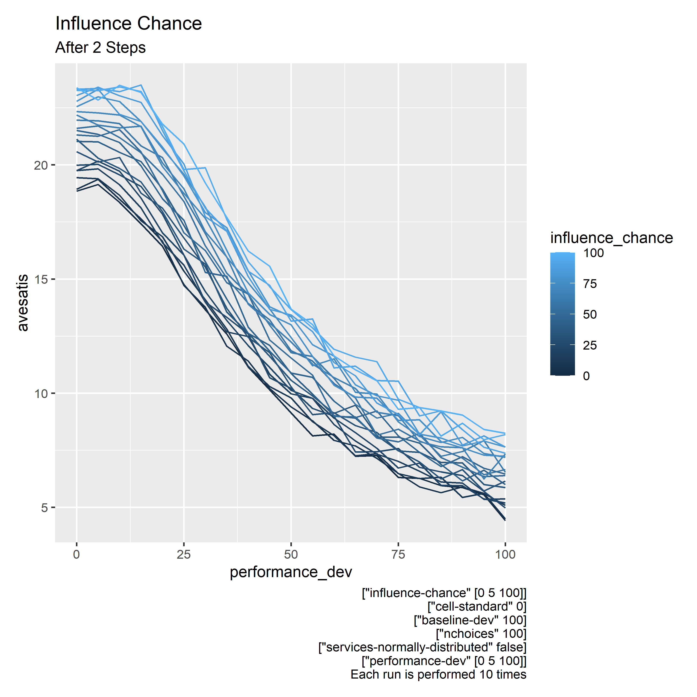

Slide 30
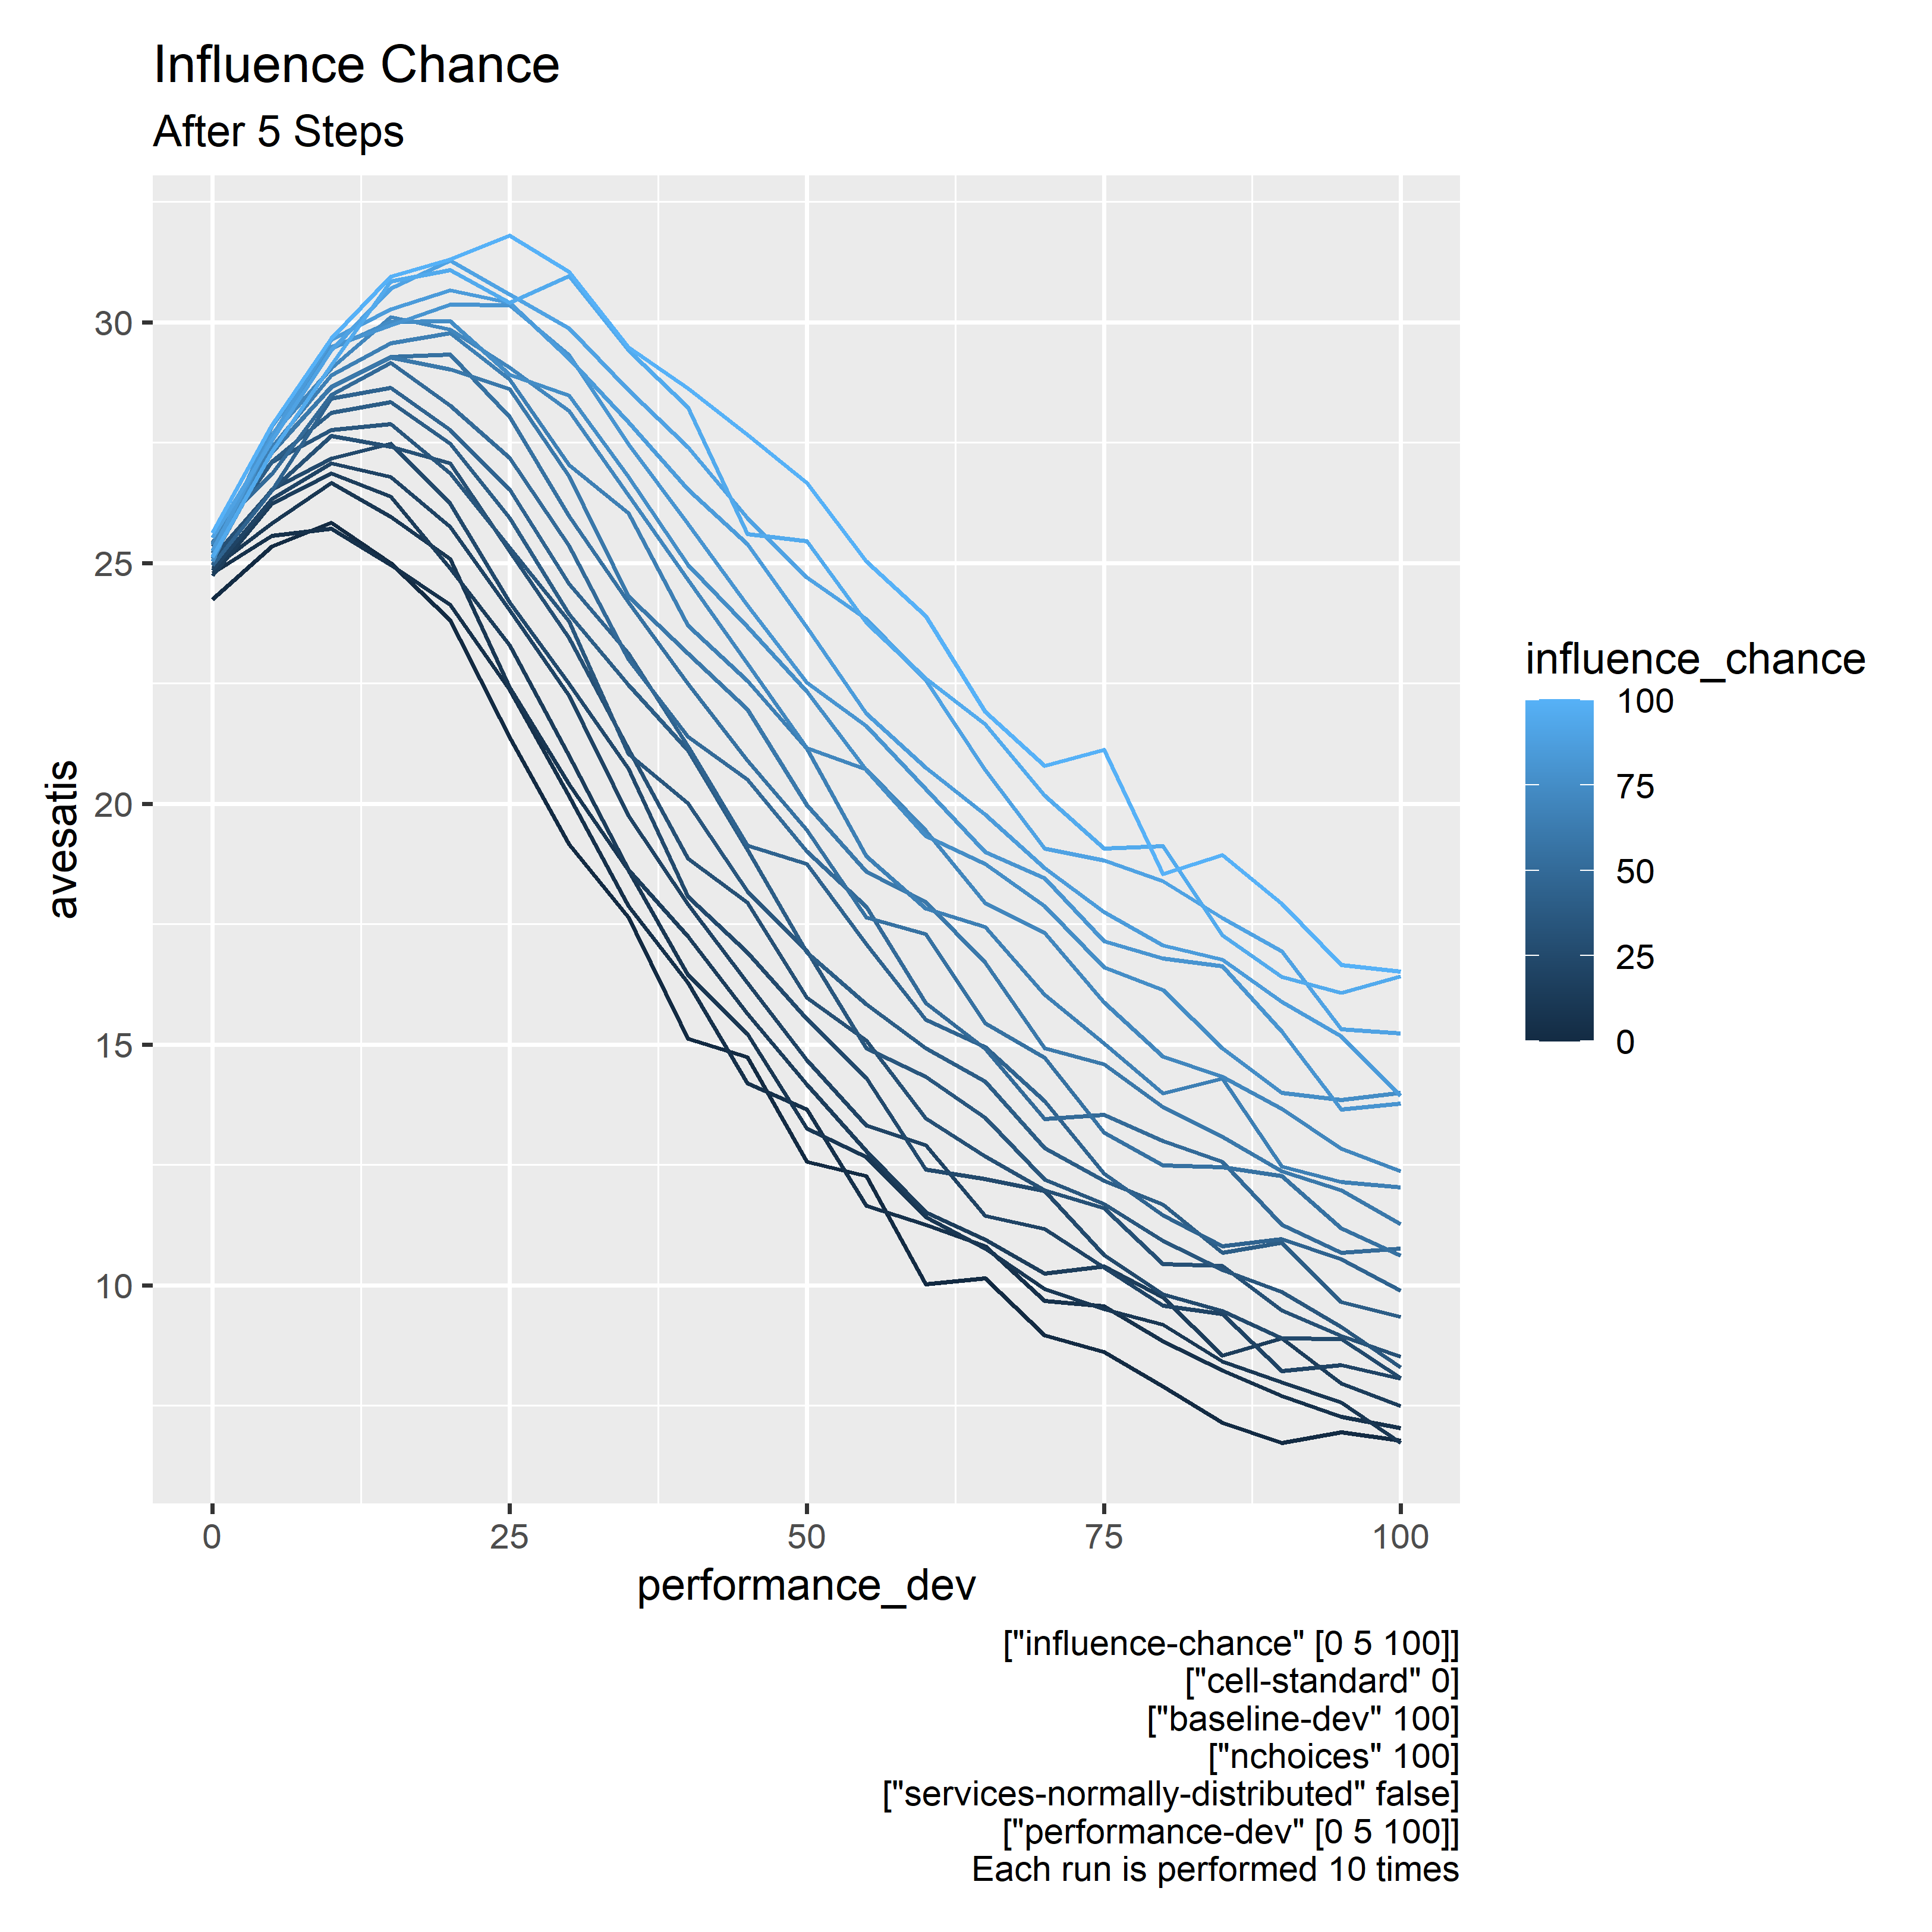

Slide 31
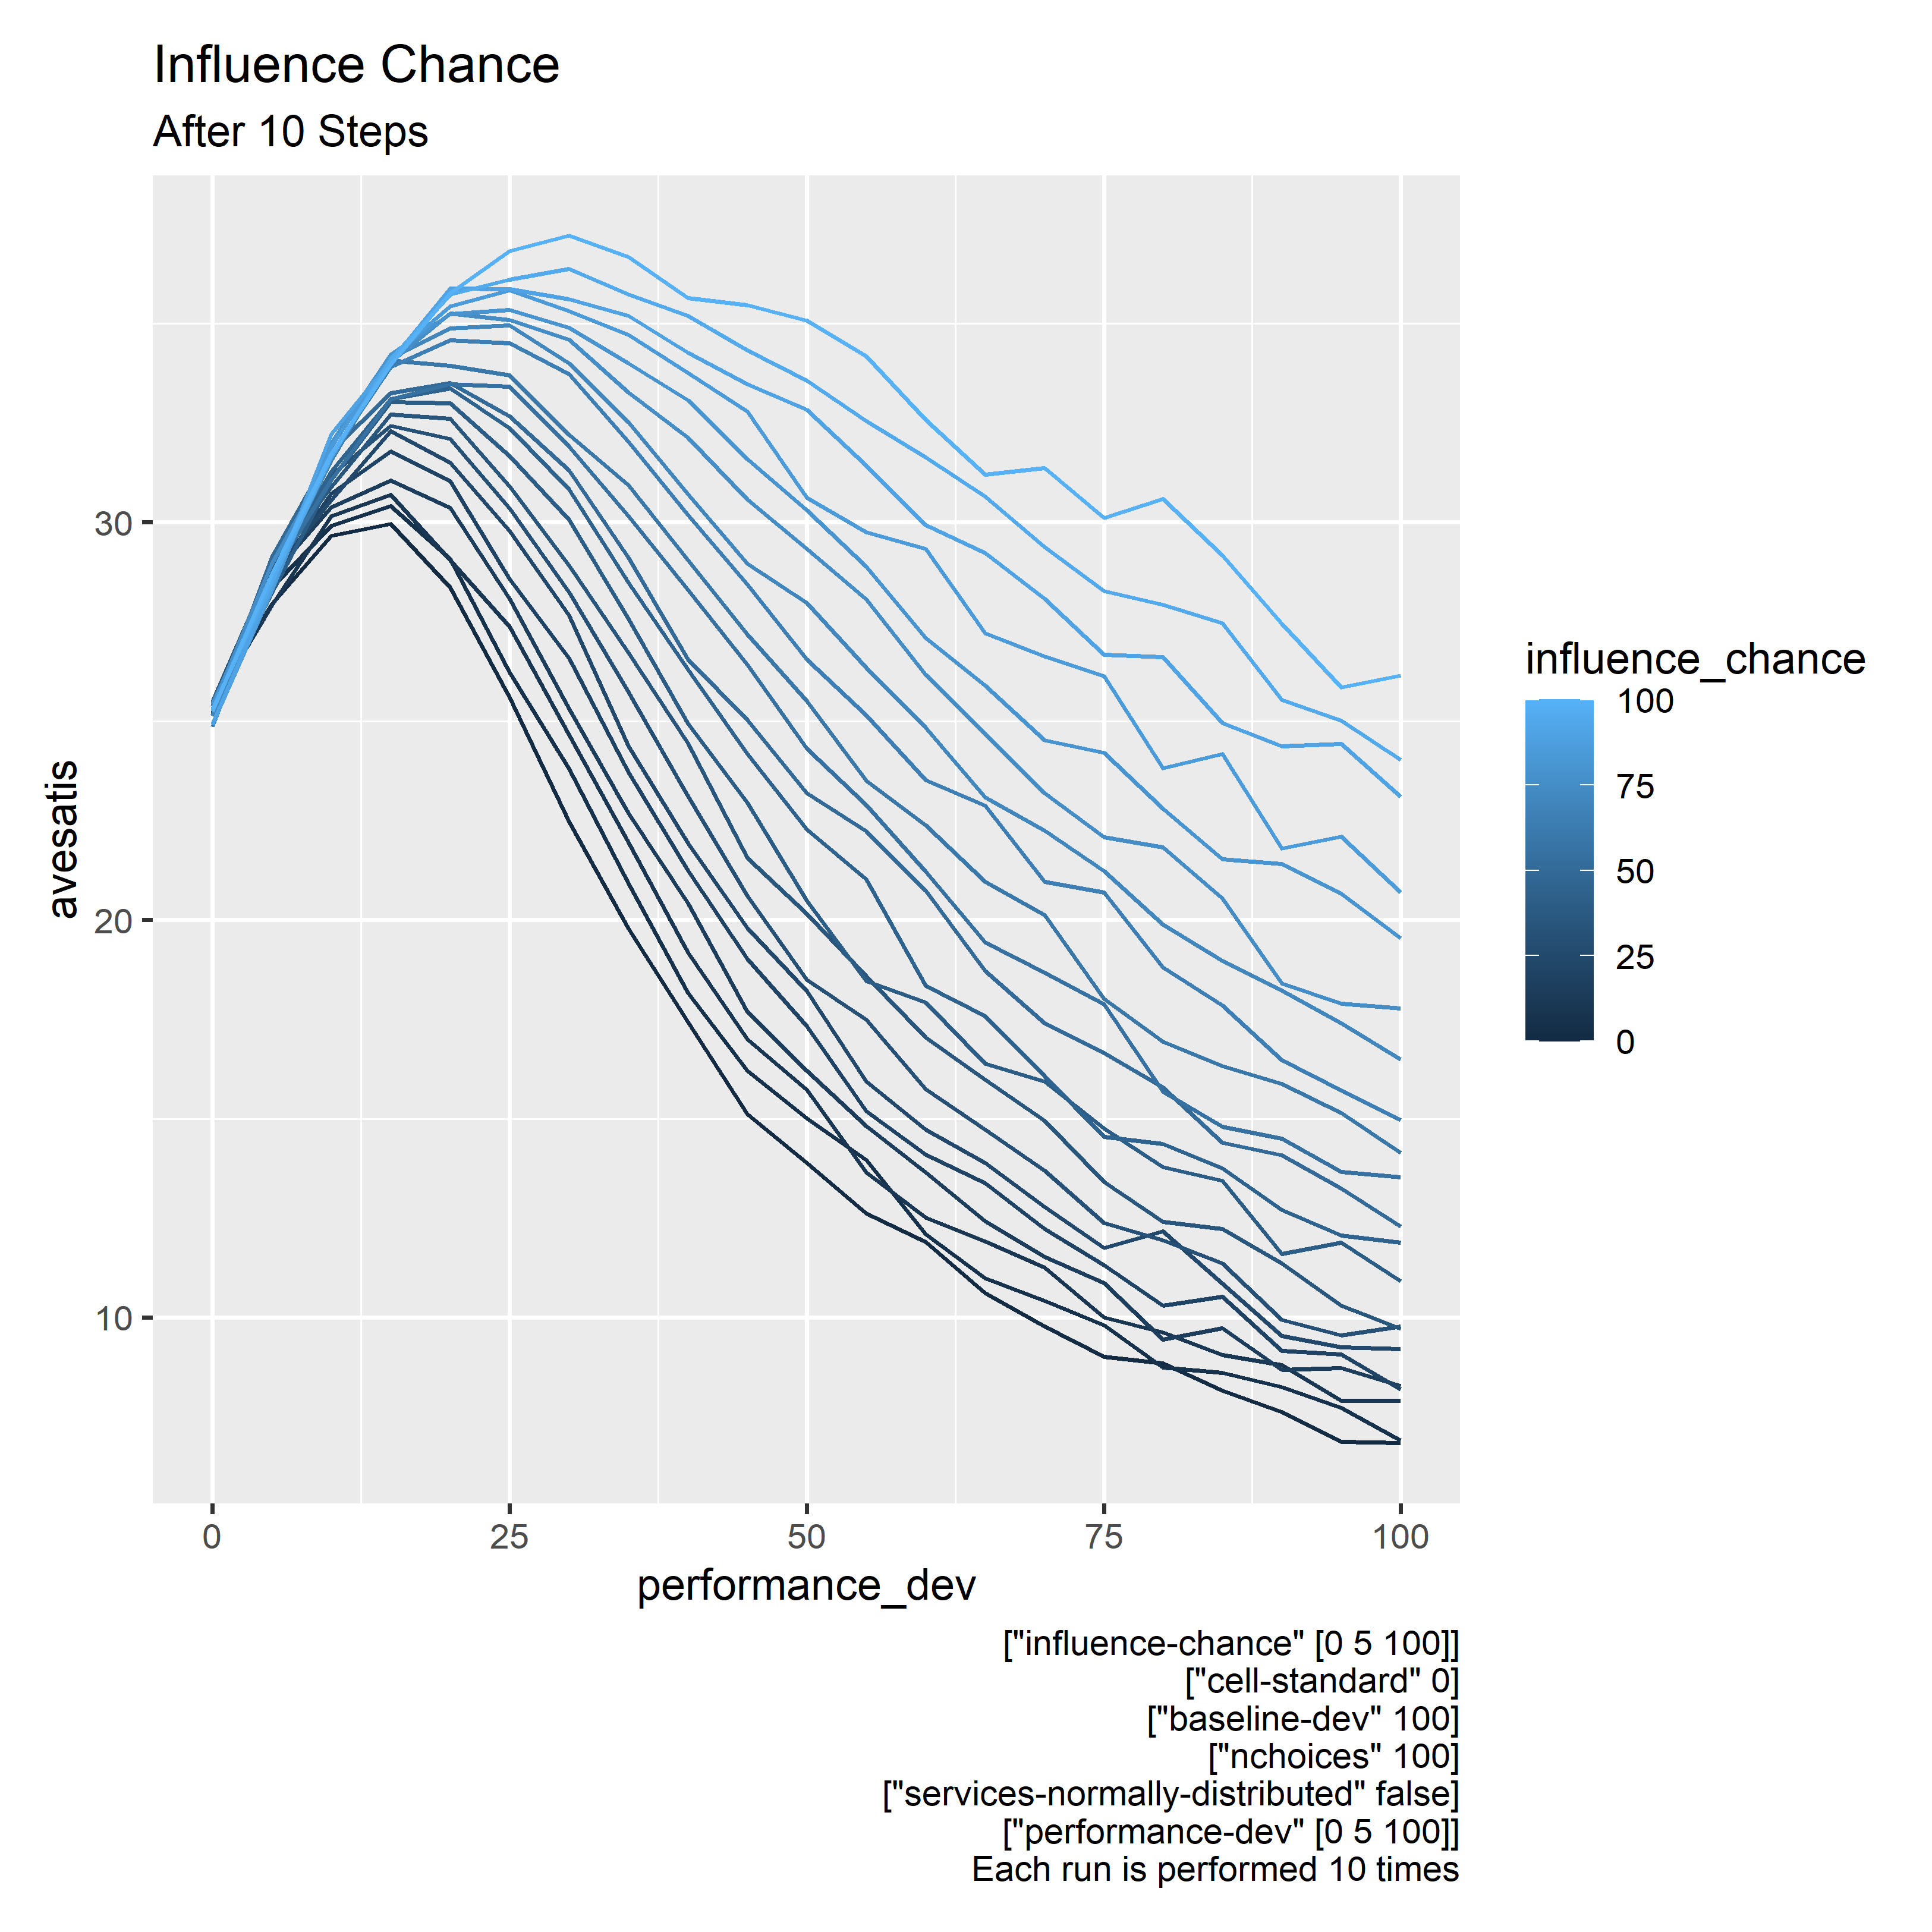

Slide 32
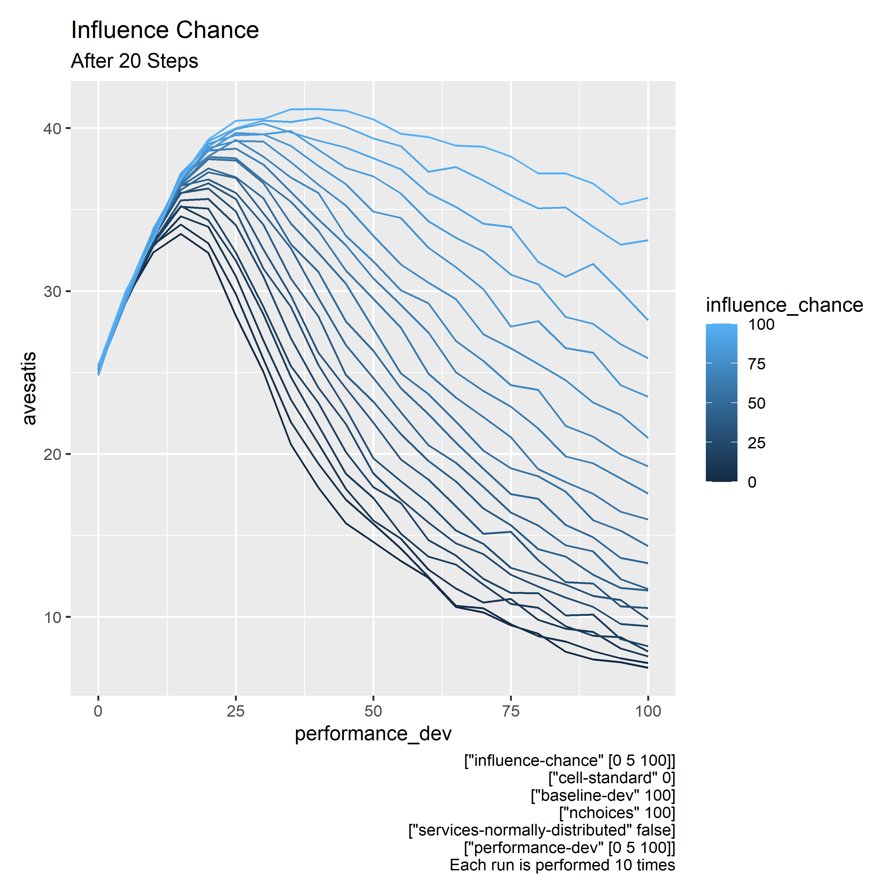

Slide 33


Slide 34
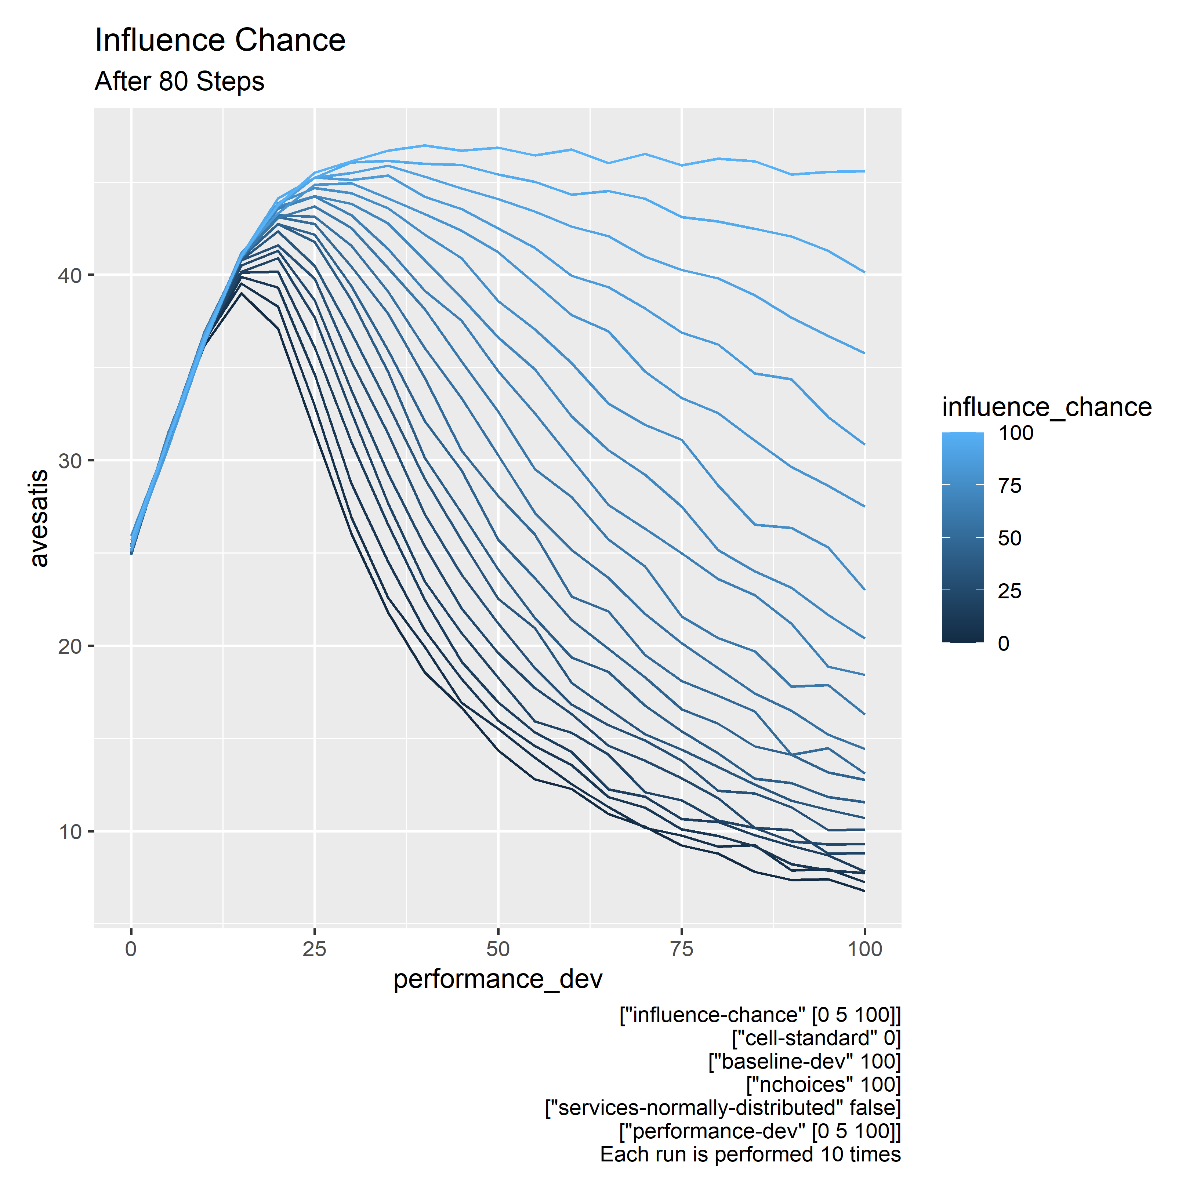

Slide 35
Observation
Herding behaviour seems to be beneficial
Higher average utility
Resilient to high uncertainty
Somehow system collectively always arrive at the best choice
“Social interaction among the agents is present but not predominant, imitative behaviours can be beneficial”
(Rossa et al., 2020, p. 13)
Emergence / Self-organised criticality

Slide 36
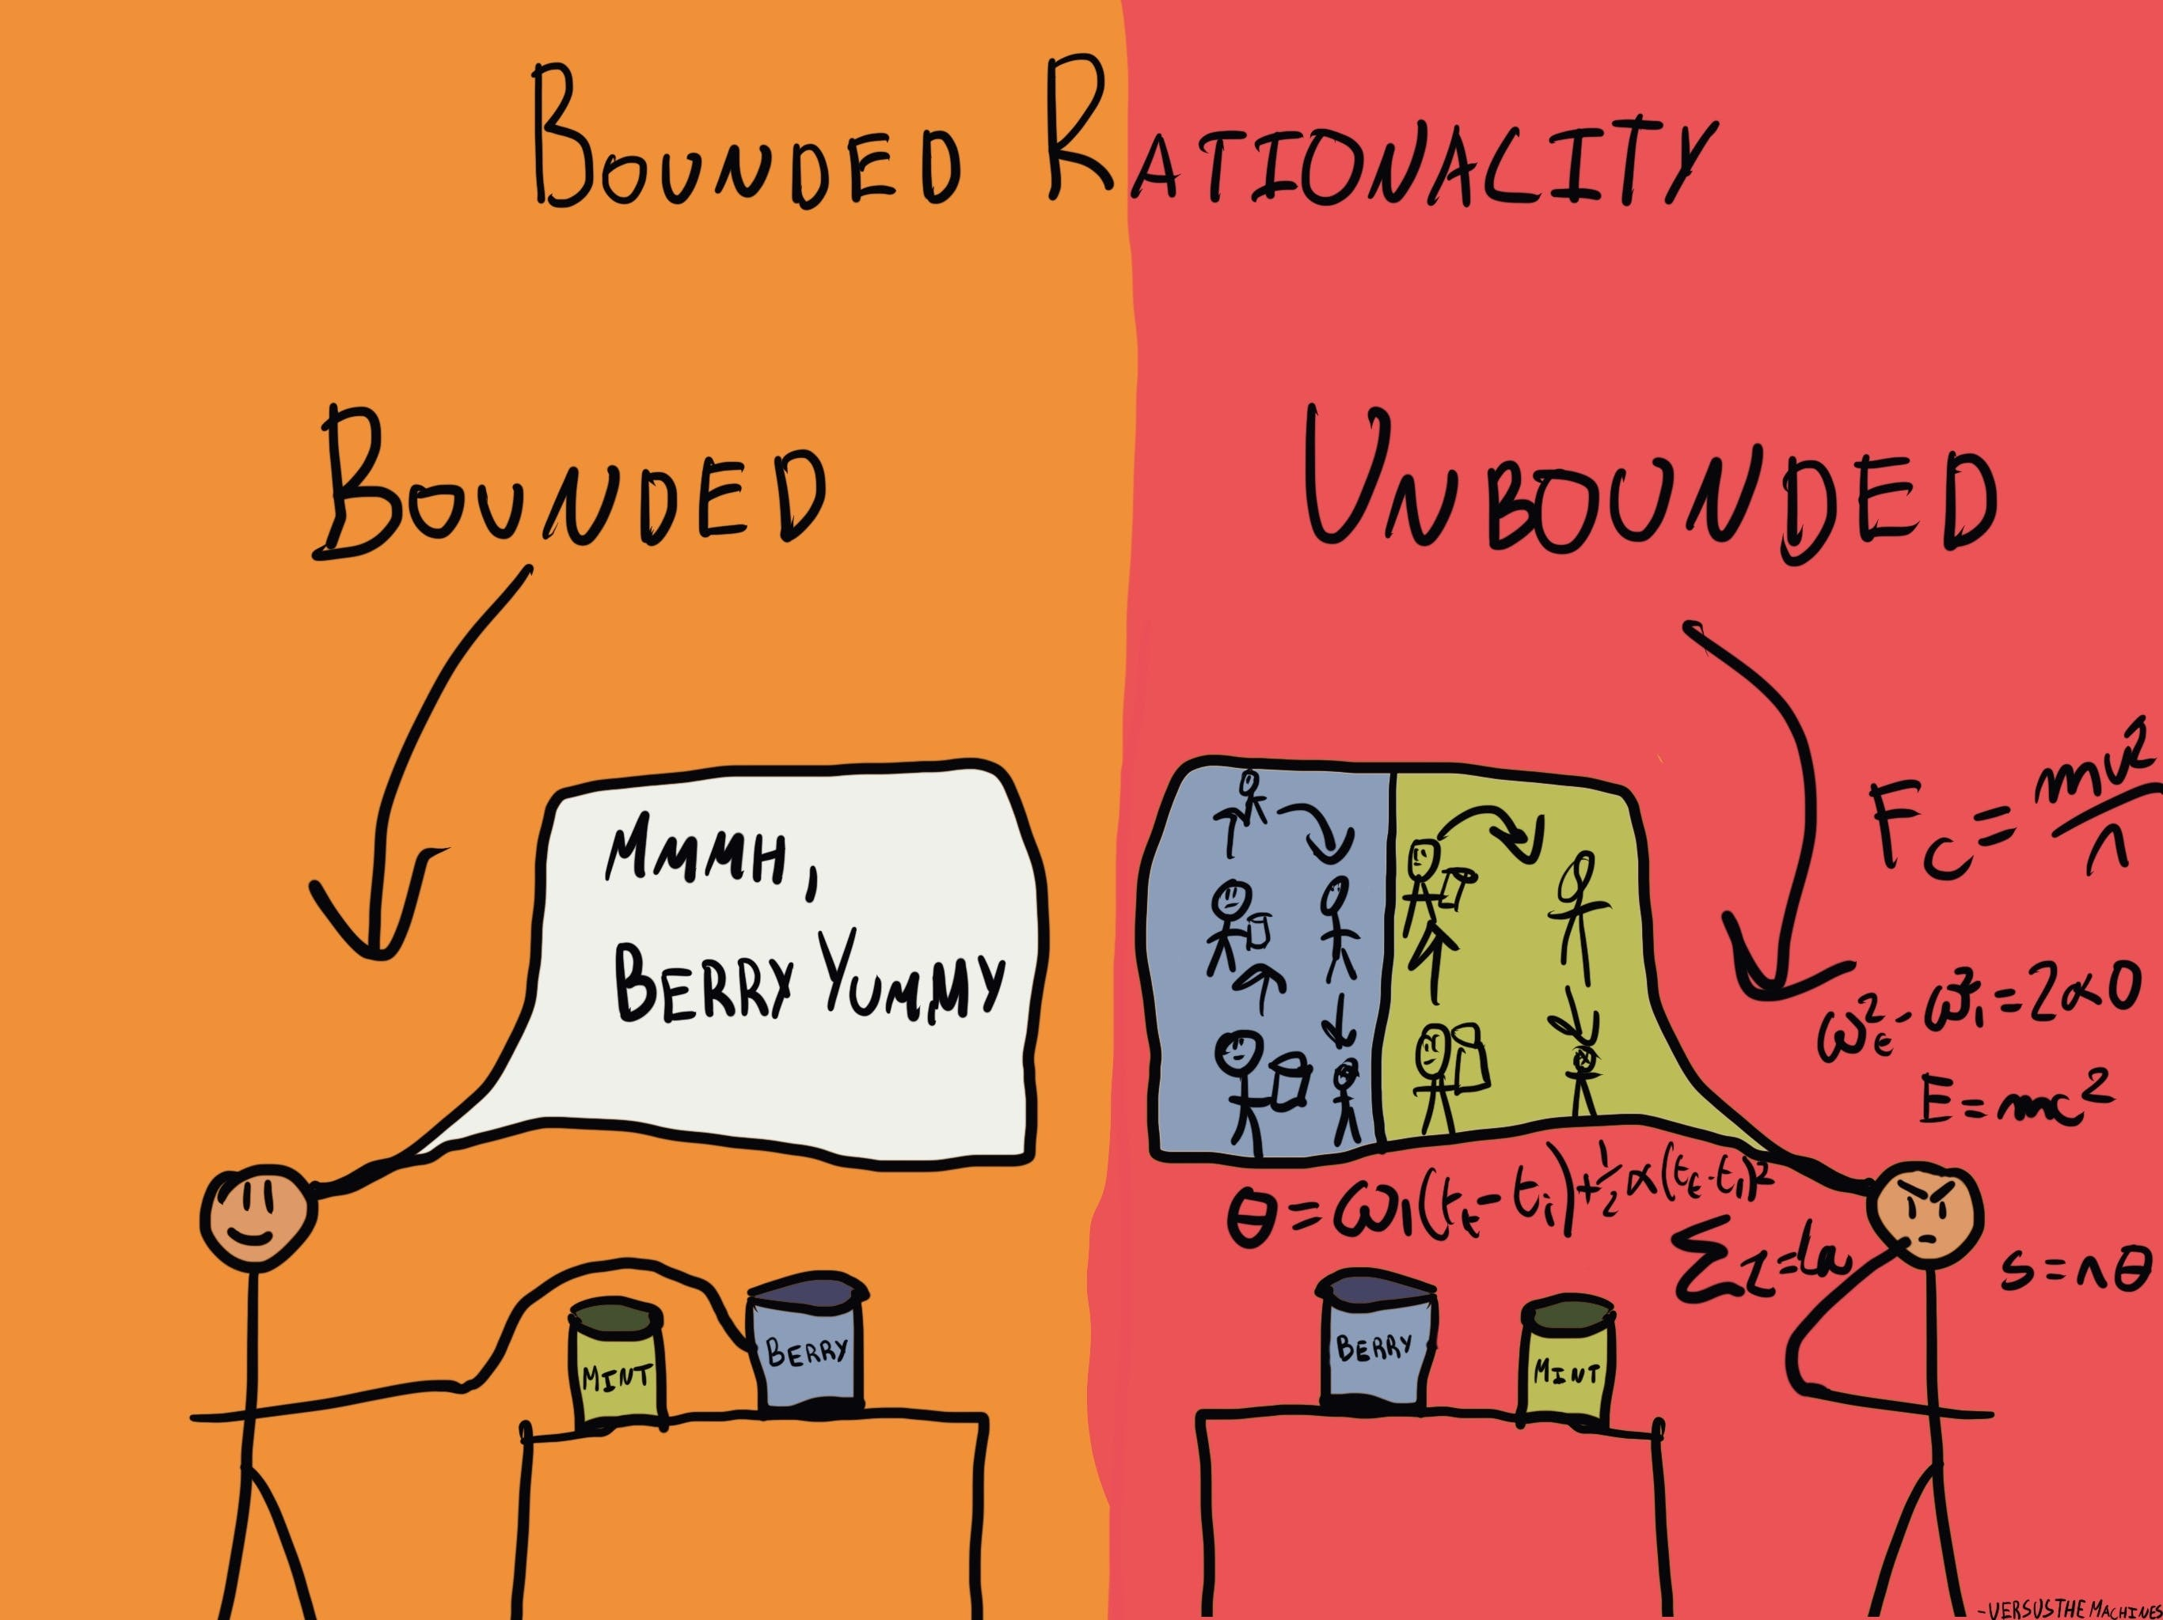
That’s all folks
Thank you

